Slide 1
ENIGMA Integrative Analysis Update
2025/01/10

Slide 2
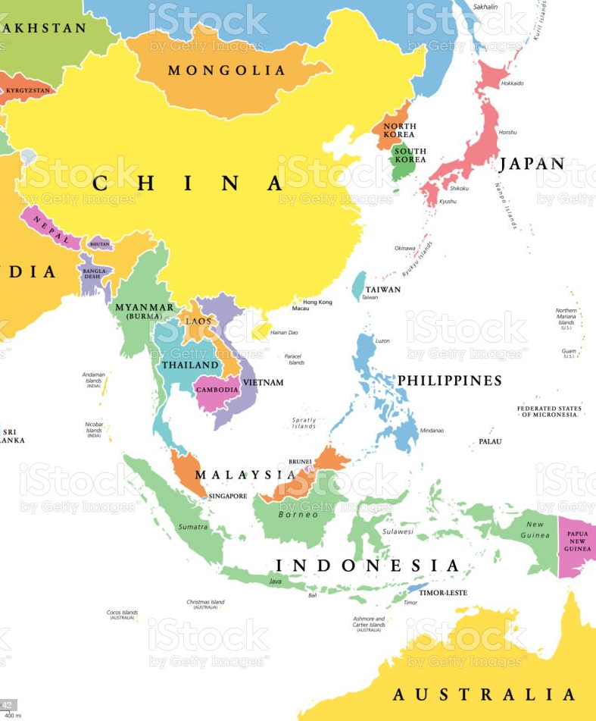
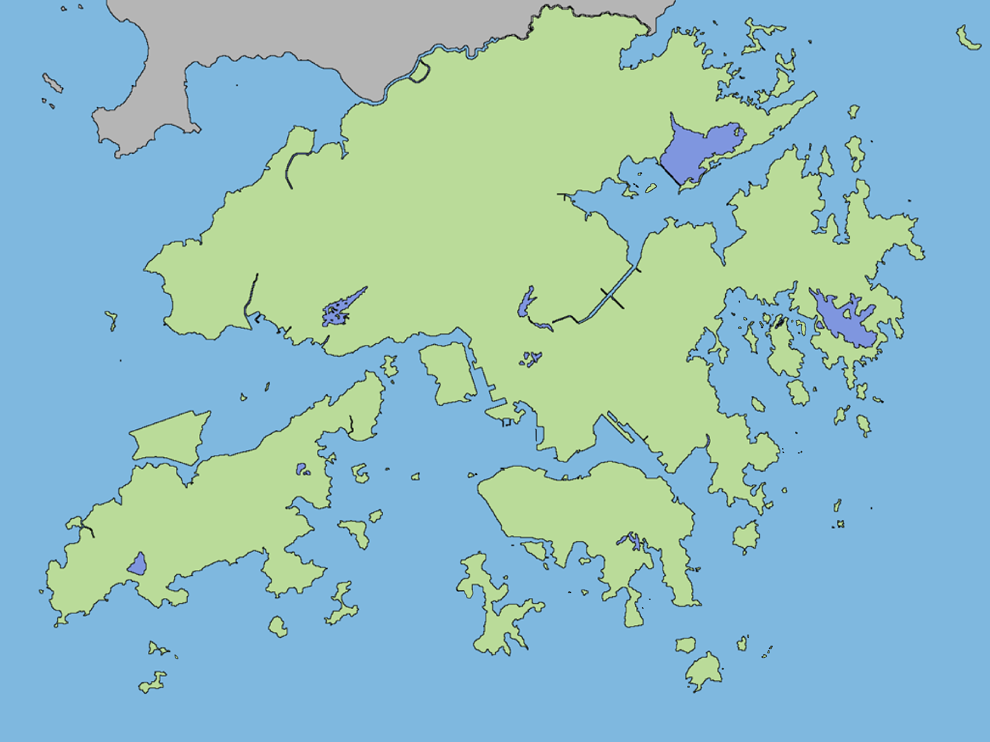
605 subjects from three regions
Subjects | Sample size (n)
Crohn’s disease | 251
Controls | 354
Kunming, China (MC)
(Asian, Rural)
Hong Kong (HK)
(Asian, Urban)
Australia (AUS)
(Caucasian, Urban)
CDAI
< 150 remission 【inactive】
150 to 219, mildly active disease; 【active】
220 to 450, moderately active disease; 【active】
> 450, severe disease【active】

Slide 3










Graphical Summary of ENIGMA Research Cohort
Species Abundance
(n =605 )
Anthropometrics
Pathway Expression
Diet
Metagenomic sequencing
(n = 479)
Gene Transcription
Early life exposures
(n = 615)
CD subjects
Controls
Medication
Biopsy 16s
rRNA sequencing
Australia
Hong Kong
Kunming
(n = 266)
Food additives
Questionnaires

Slide 4
Aims
To illuminate the signatures of microbiome, microbial genes and functional pathways in CD patients and controls cross populations
To uncover the clinical information, environmental factors and bacterial features that may correlated with disease activity in CD
Microbiome
causal
CD
DE
Genes
Pathways
Clinical Info
CD
Dietary
Environment

Slide 5
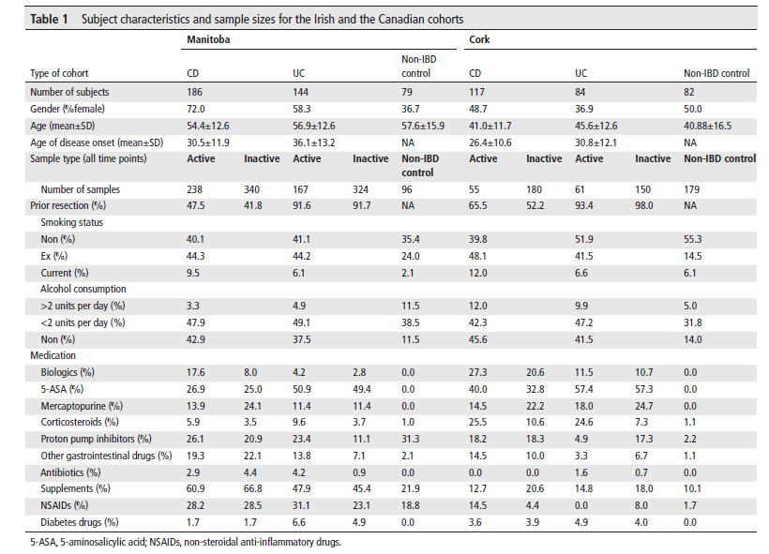
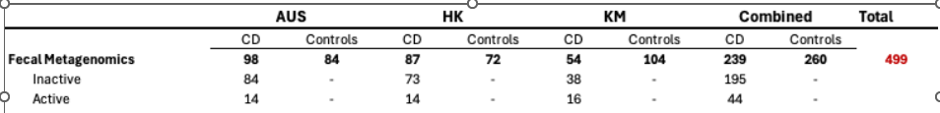
分类 | 示例变量
研究标识 | study_id, record_id, gp_arm
受试者类型 | re_arm, tissue_cohort
人口统计学 | age_final, gender, region
疾病特征 | cd_site1, cd_behaviour___1
实验室指标 | hb, crp, esr
配对关系 | pairfdrnew, triads
饮食数据 | breast_fed, p80, protein_g
药物治疗 | cd_tx_biologic, cd_biologic_type
临床其他 | bowel_resection, smoke
Notes:
Ranking microbiome variance in inflammatory bowel disease: a large longitudinal intercontinental study

Slide 6
Corrplot
CDAI VS Fecal calprotectin
Spearman correlation
HK
AUS
HK+AUS
KM(补充)

Slide 7
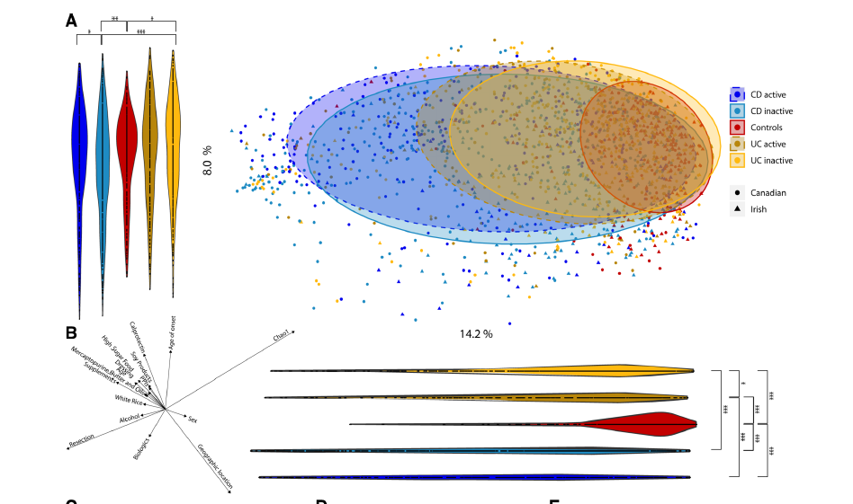
Species table PCoA
1. By diease status,CD active, inactive, controls 2. By region
Gut microbiome composition （PCOA）
Notes:
Ranking microbiome variance in inflammatory bowel disease: a large longitudinal intercontinental study

Slide 8
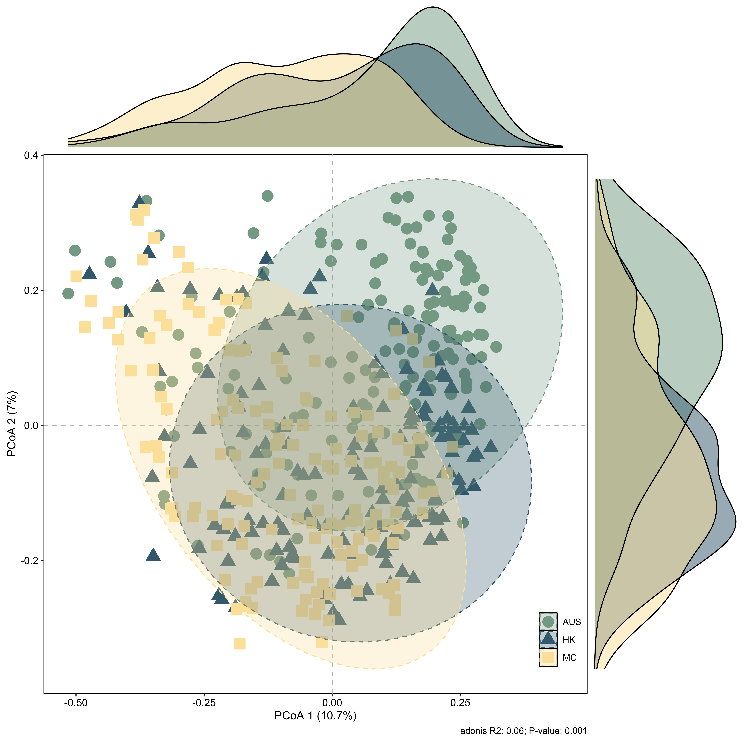
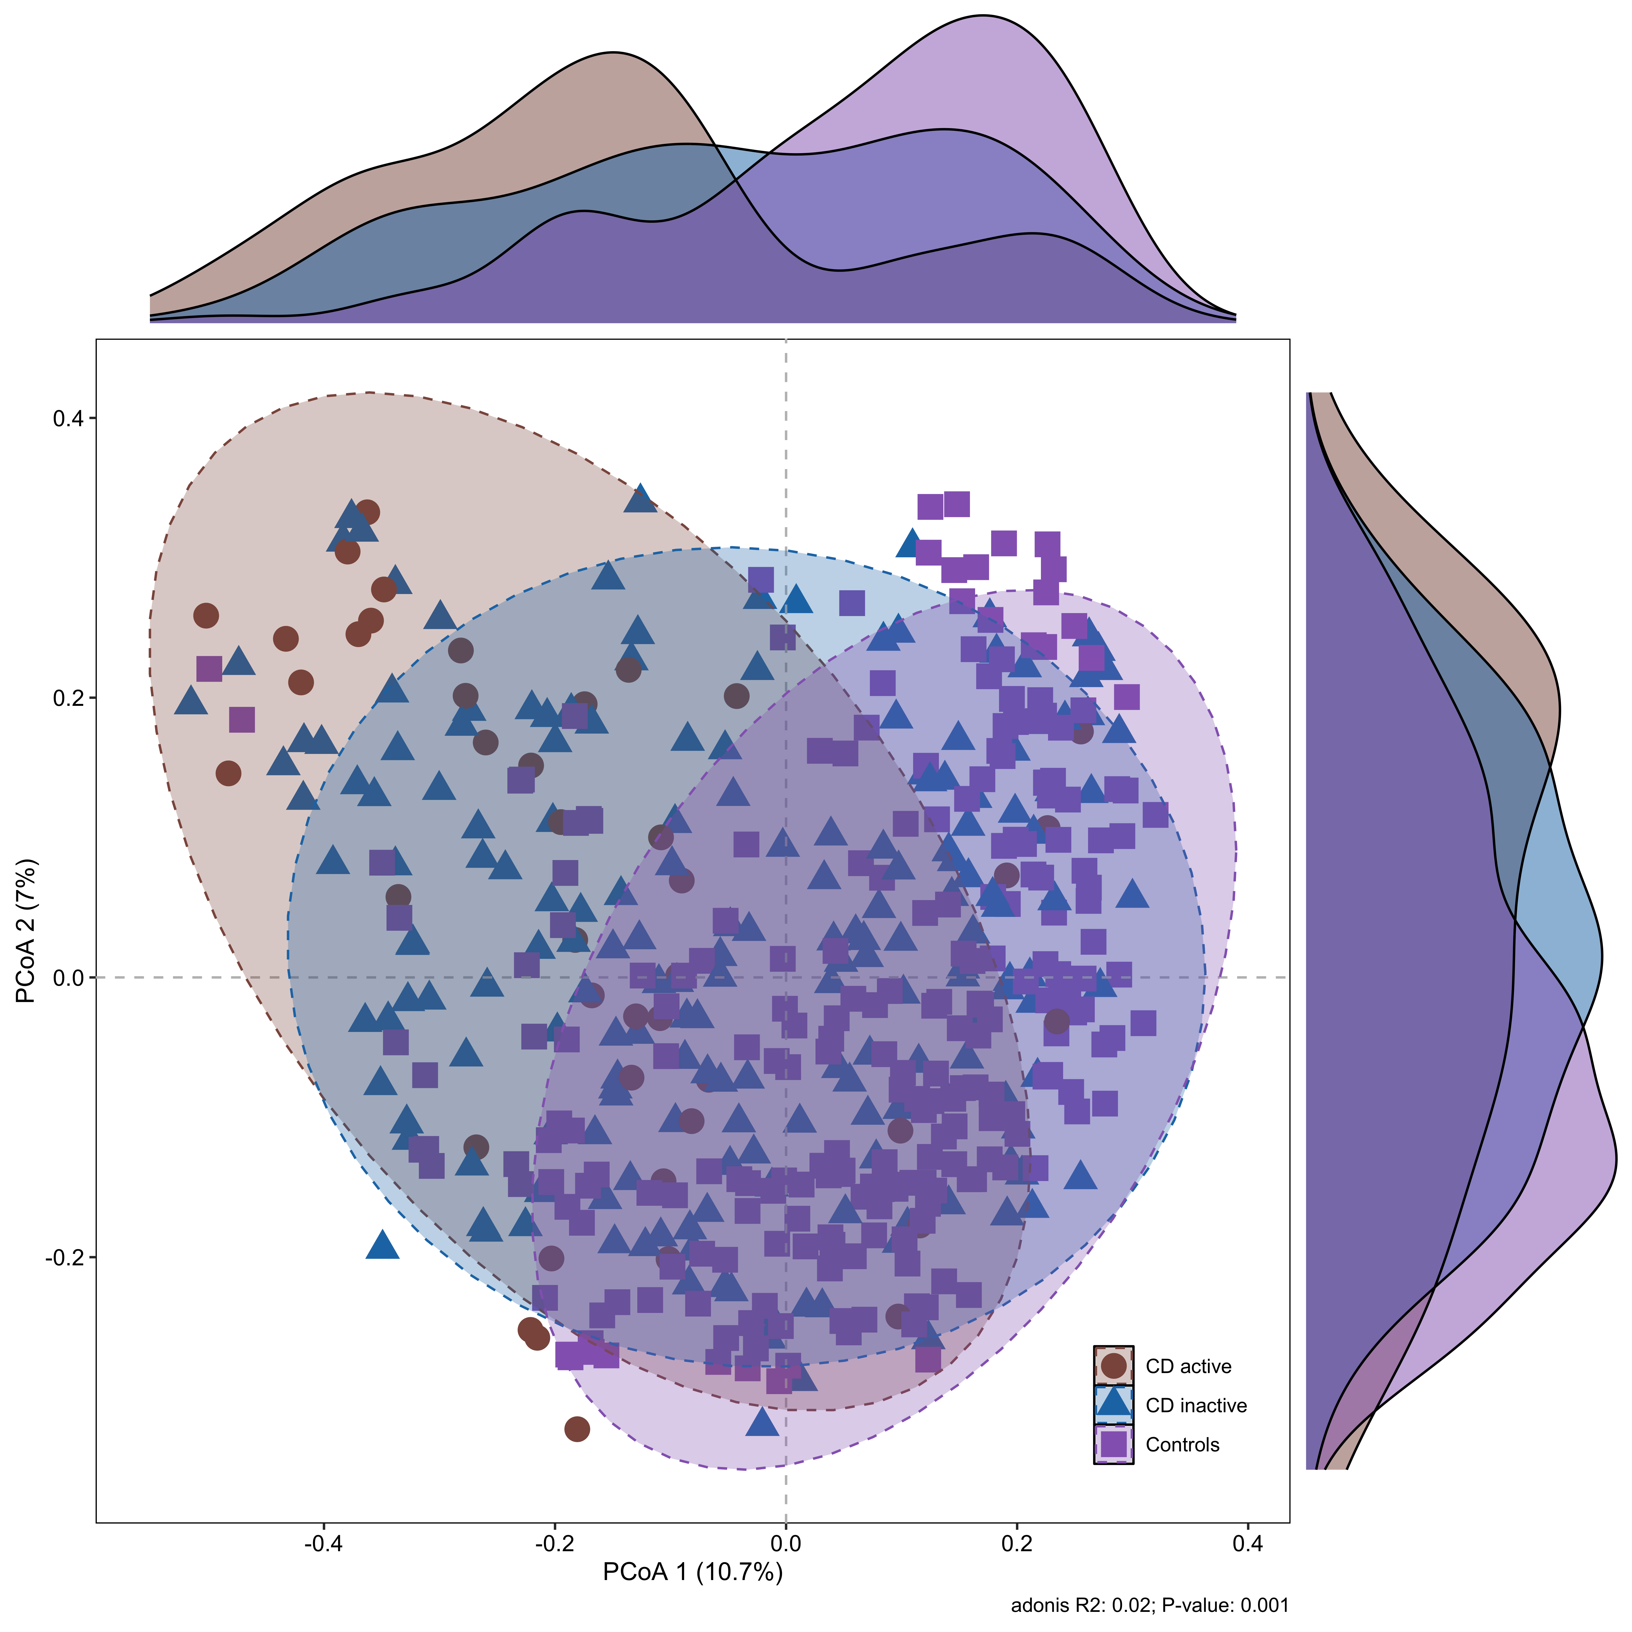

Slide 9
Shannon Diversity and Observed Species Number cross AUS, HK, and KM
Shannon Index
Observed Species
CD Controls

Slide 11
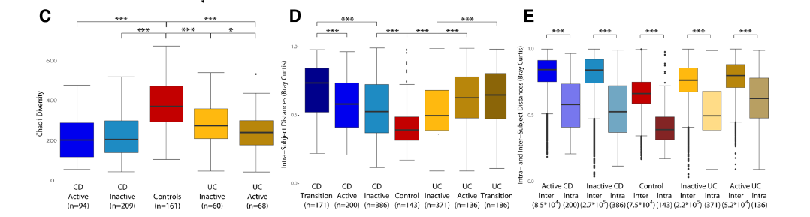
C (chao1):
Alpha 衡量不同组别（CD、UC、健康对照组） 肠道微生物群的丰富度（即物种数量）。
DE （bray-curtis）: Beta 衡量两个样本间物种组成的差异 （0=完全相同，1=完全不同）
Intra:纵向，不同时间点， 同一样本之间的bray-curtis 距离 Inter:横向，同一时间点， 不同样本之间的bray-curtis 距离
Notes:
Ranking microbiome variance in inflammatory bowel disease: a large longitudinal intercontinental study
这篇文献中不仅有横线分组，也有纵向分组： 纵向采样设计
所有患者和对照组在 3个时间点 采集样本（间隔约16周），用于分析微生物群的动态变化。
每个时间点的样本分为 活动期 或 非活动期（IBD患者）或保持稳定状态（对照组）。

Slide 13
我的研究中采用： Inter：横向，即同一时间点， 不同样本之间的bray-curtis 距离 Within == Inter

Slide 14
Microbiome Analysis Workflow
Relative Abundance of Bacterial Species
Venn Diagram
Venn Diagram
Data Filtering
Venn Diagram
Bar Plots
MaAsLin2
Venn Diagram
Heatmap
CD-enriched and CD-depleted Species
Notes:
MaAsLin2（Multivariate Association with Linear Models）是一种用于分析微生物组数据的统计工具，专门用于检测微生物组数据与其他元数据（如临床变量、环境因素等）之间的关联。它是MaAsLin的升级版，由Huttenhower Lab开发，广泛应用于微生物组学研究。

Slide 15
Venn Diagram for Bacterial Species
Unfiltered
Filtered (qvalue<0. 25)

Slide 17
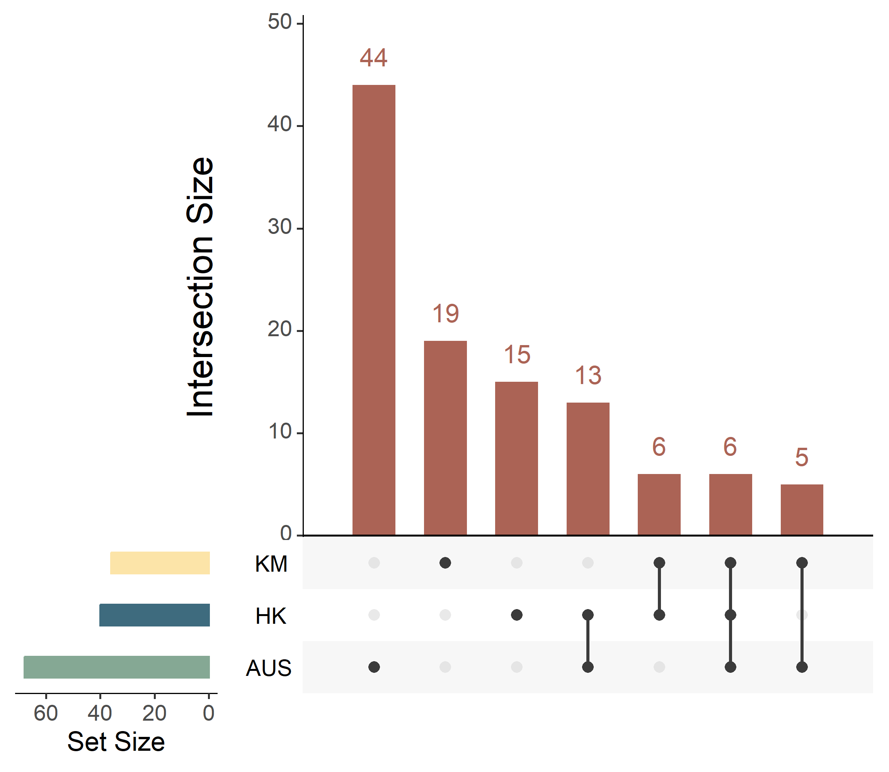
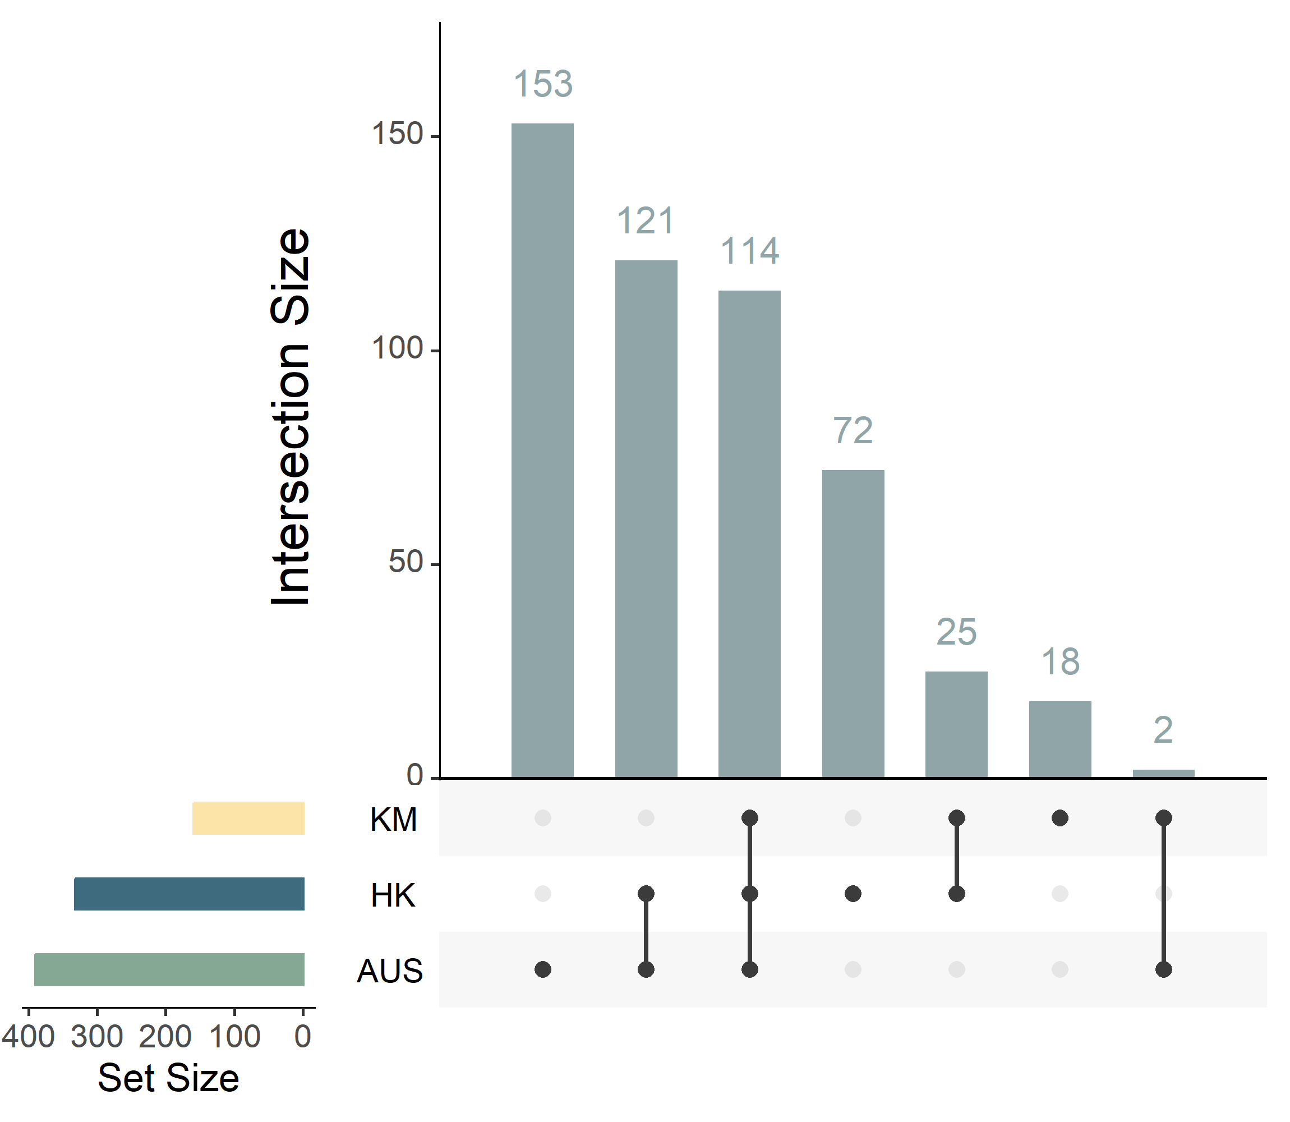
Comparison of CD-enriched and CD-depleted species among AUS, HK, and KM
CD-enriched bacteria
CD-depleted bacteria
36
159
40
332
68
390

Slide 18
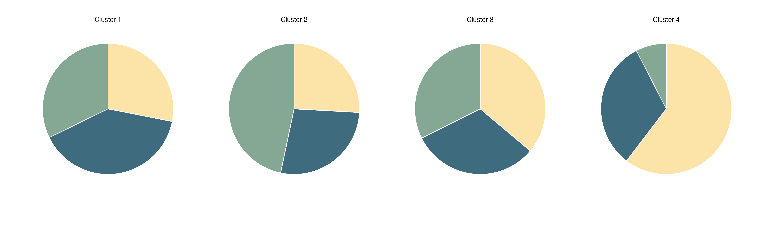
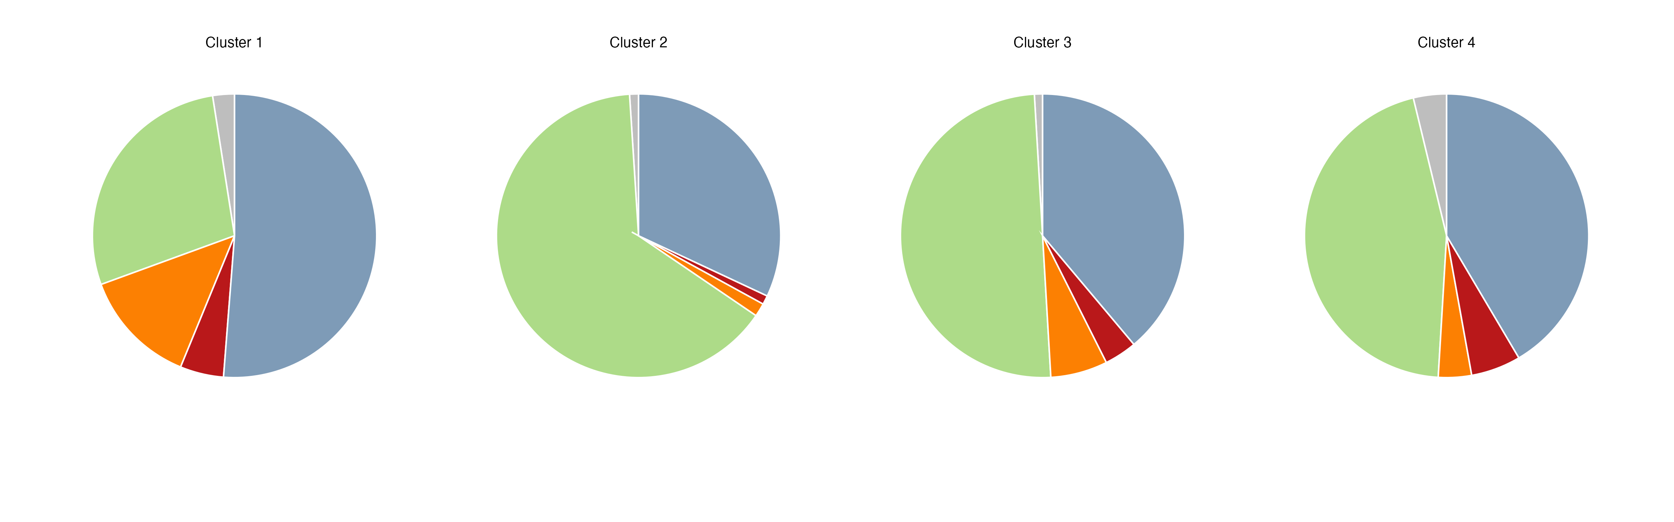

Slide 19
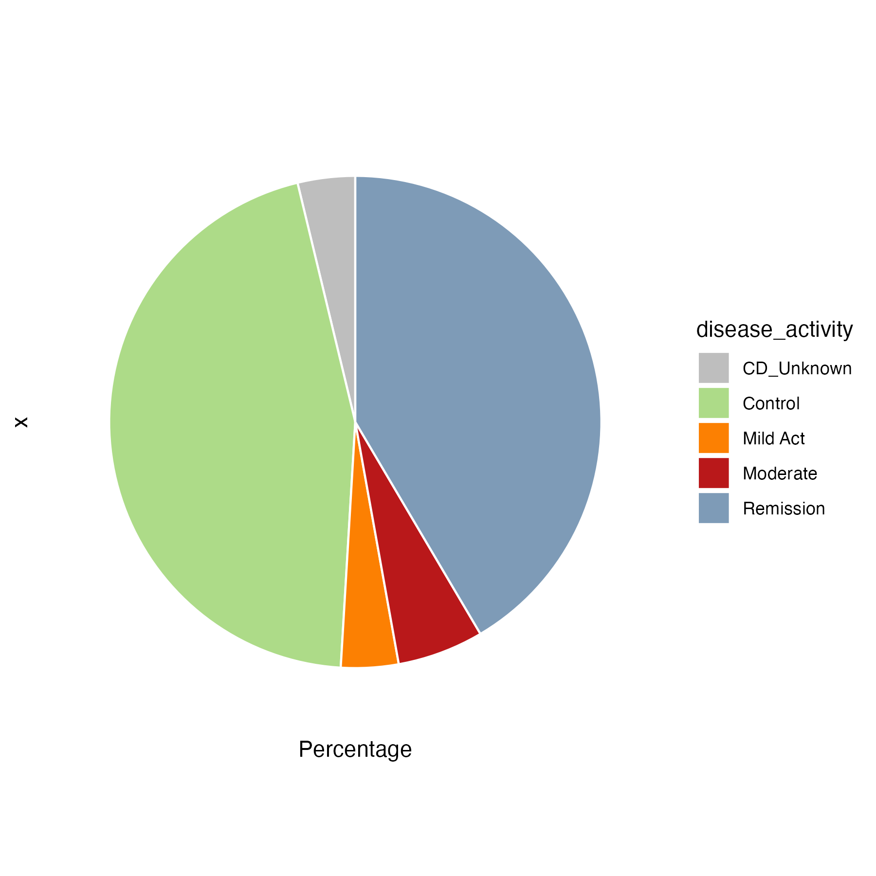
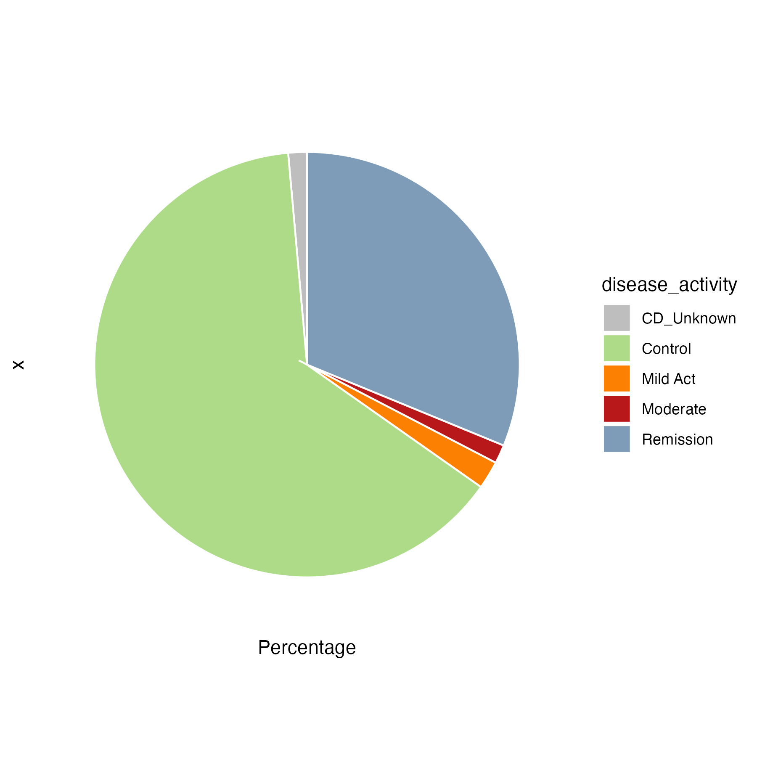
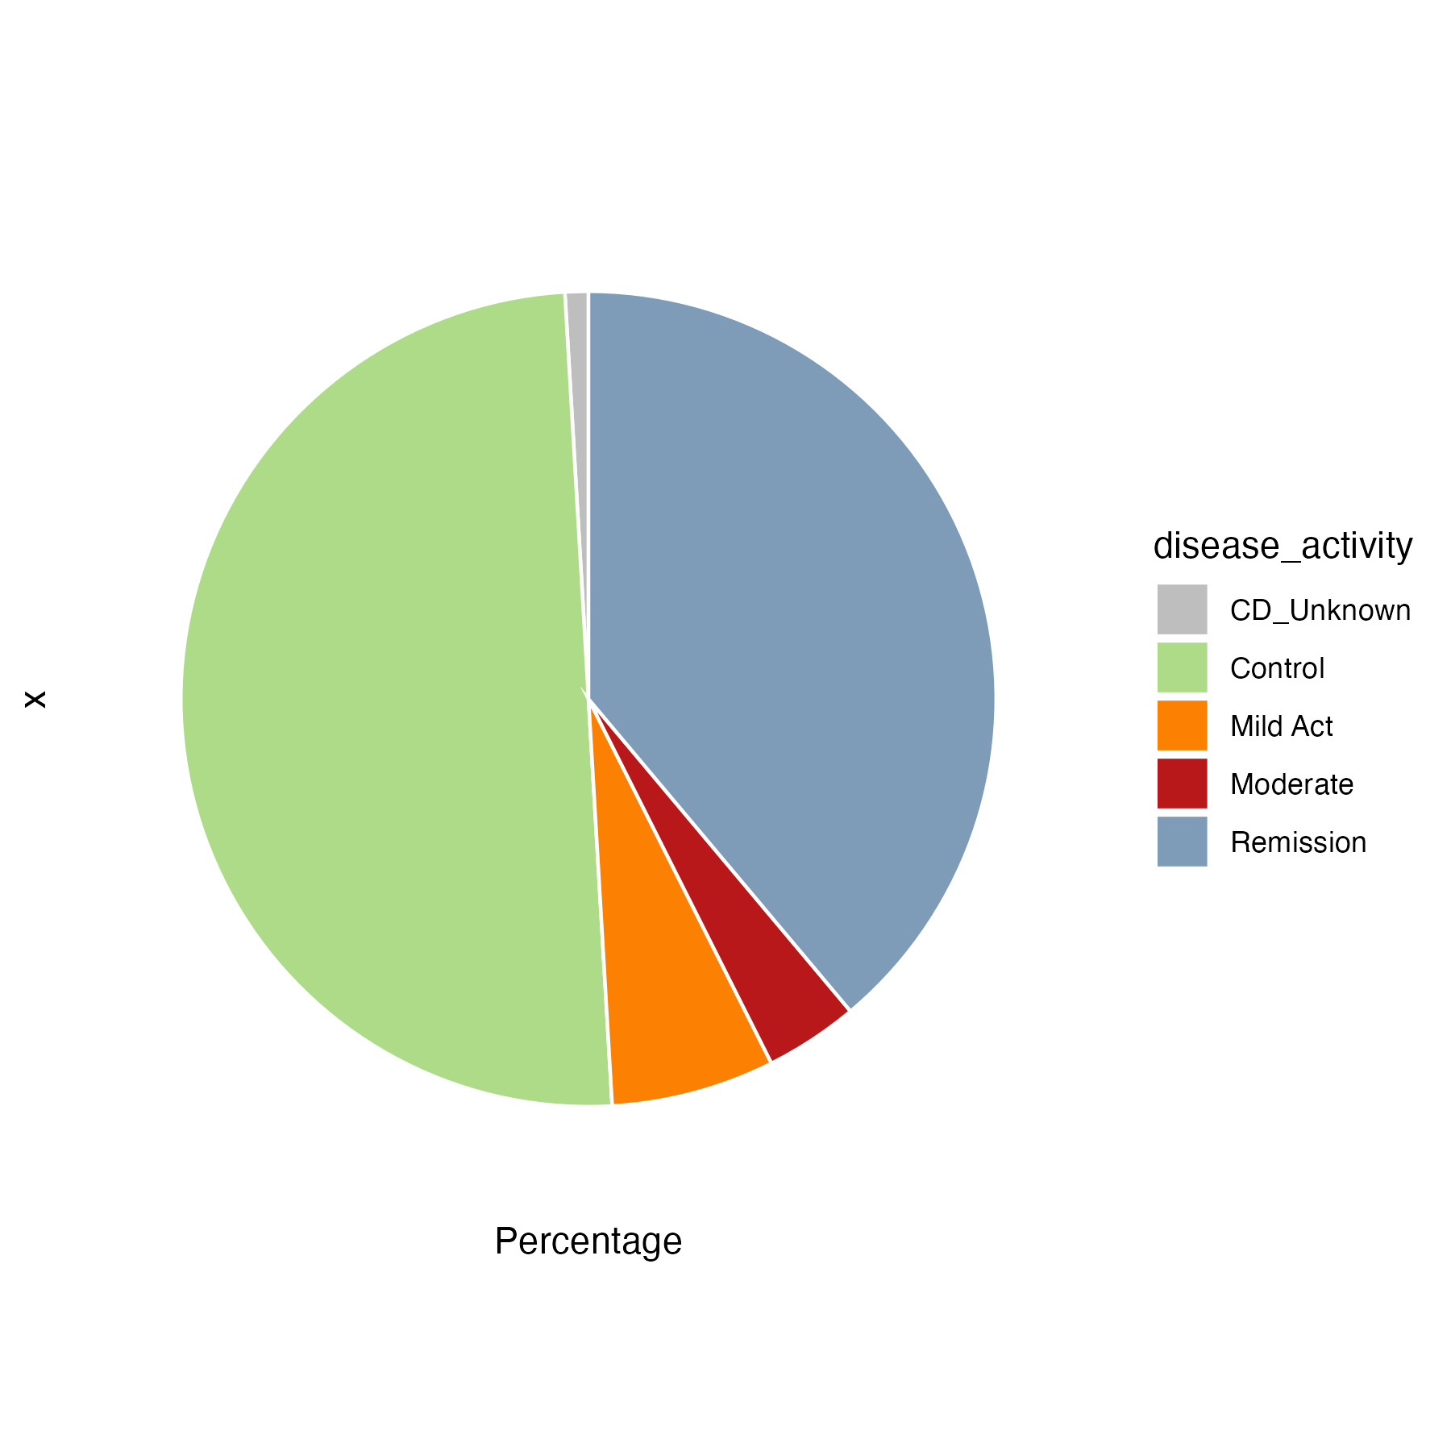
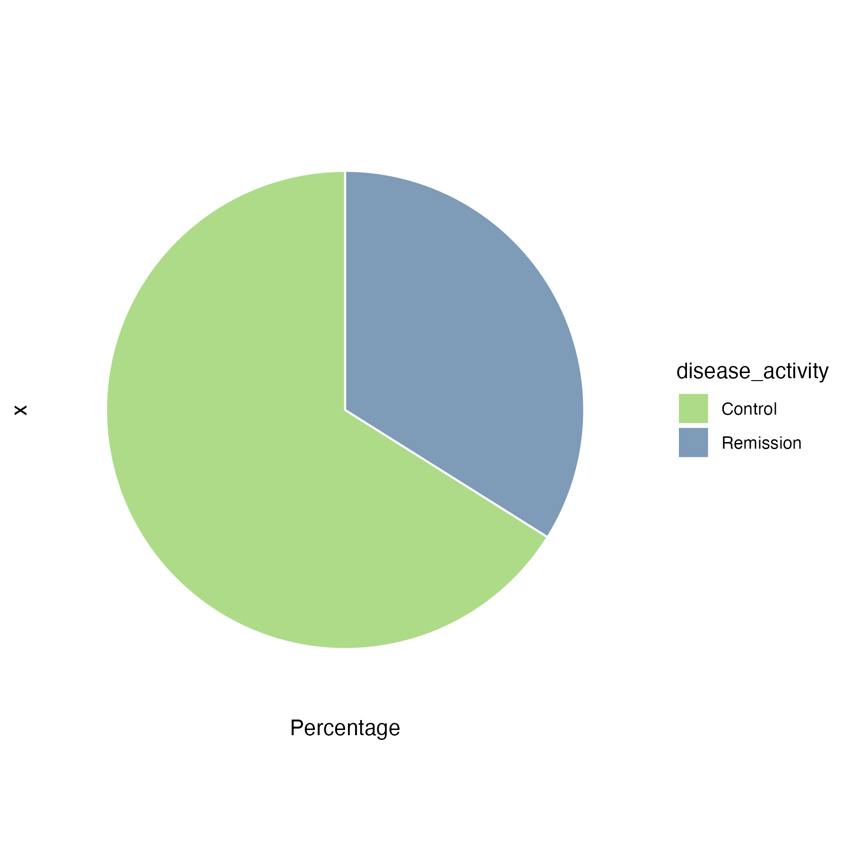
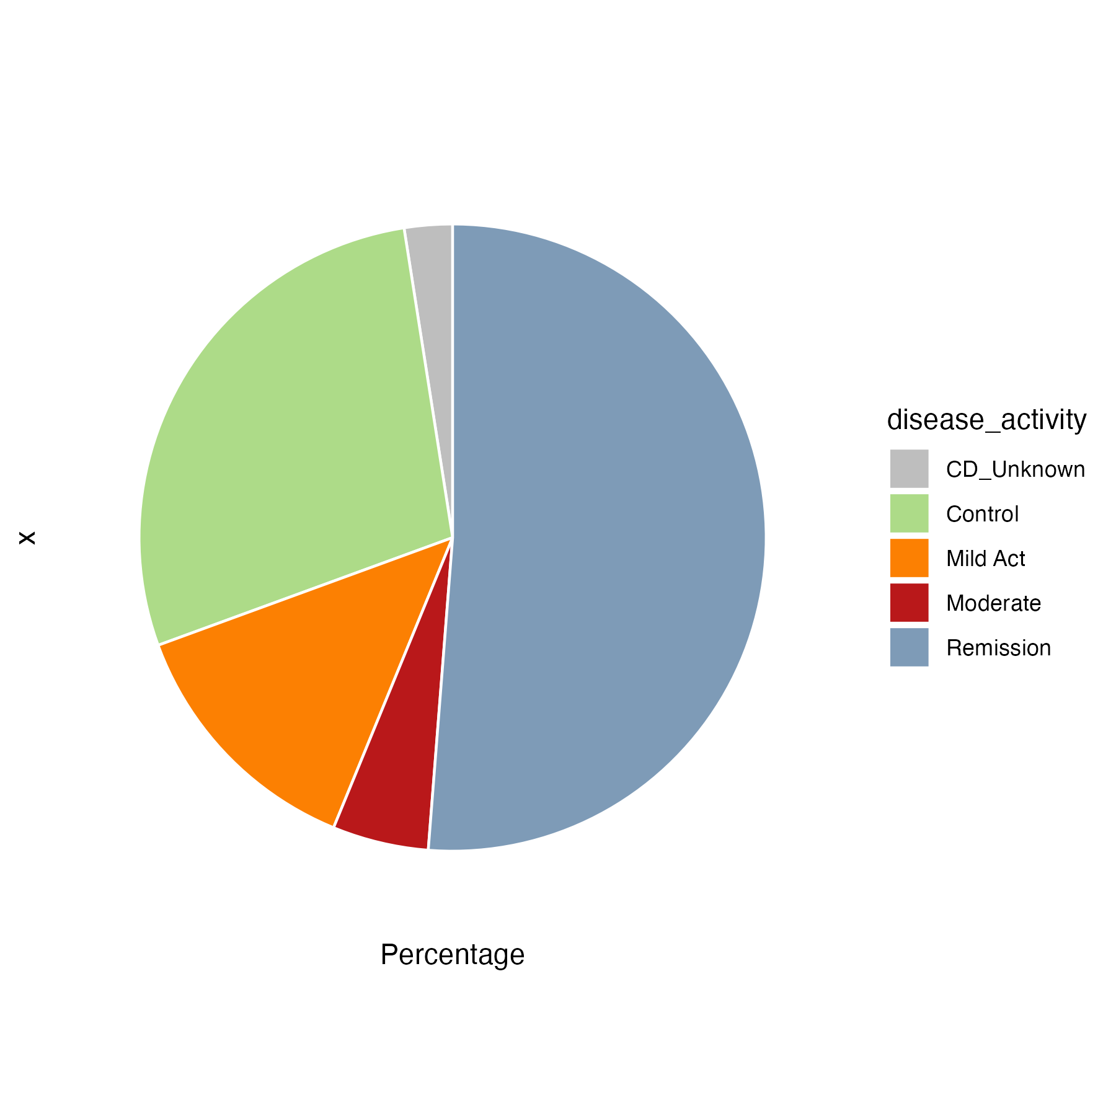
Comparison | P_Value | Statistic
1 vs 2 | 4.84600464899138e-08 | 5280
1 vs 3 | 4.69278734666627e-05 | 6708
1 vs 4 | 0.16759359696115 | 3826
1 vs 5 | 0.13372036842916 | 7285
1 vs 6 | 3.09661002627813e-07 | 4772
2 vs 3 | 7.85152216398767e-05 | 1464
2 vs 4 | 2.04045575238199e-08 | 634
2 vs 5 | 5.93933372017608e-05 | 1946
2 vs 6 | 0.964682568386495 | 1545
3 vs 4 | 0.000126758384215804 | 1431
3 vs 5 | 0.164458264798622 | 3955
3 vs 6 | 0.0141184898537886 | 2750
4 vs 5 | 0.138221665415586 | 3452
4 vs 6 | 1.74948754378218e-06 | 2273
5 vs 6 | 0.0104817392871642 | 3574

Slide 20
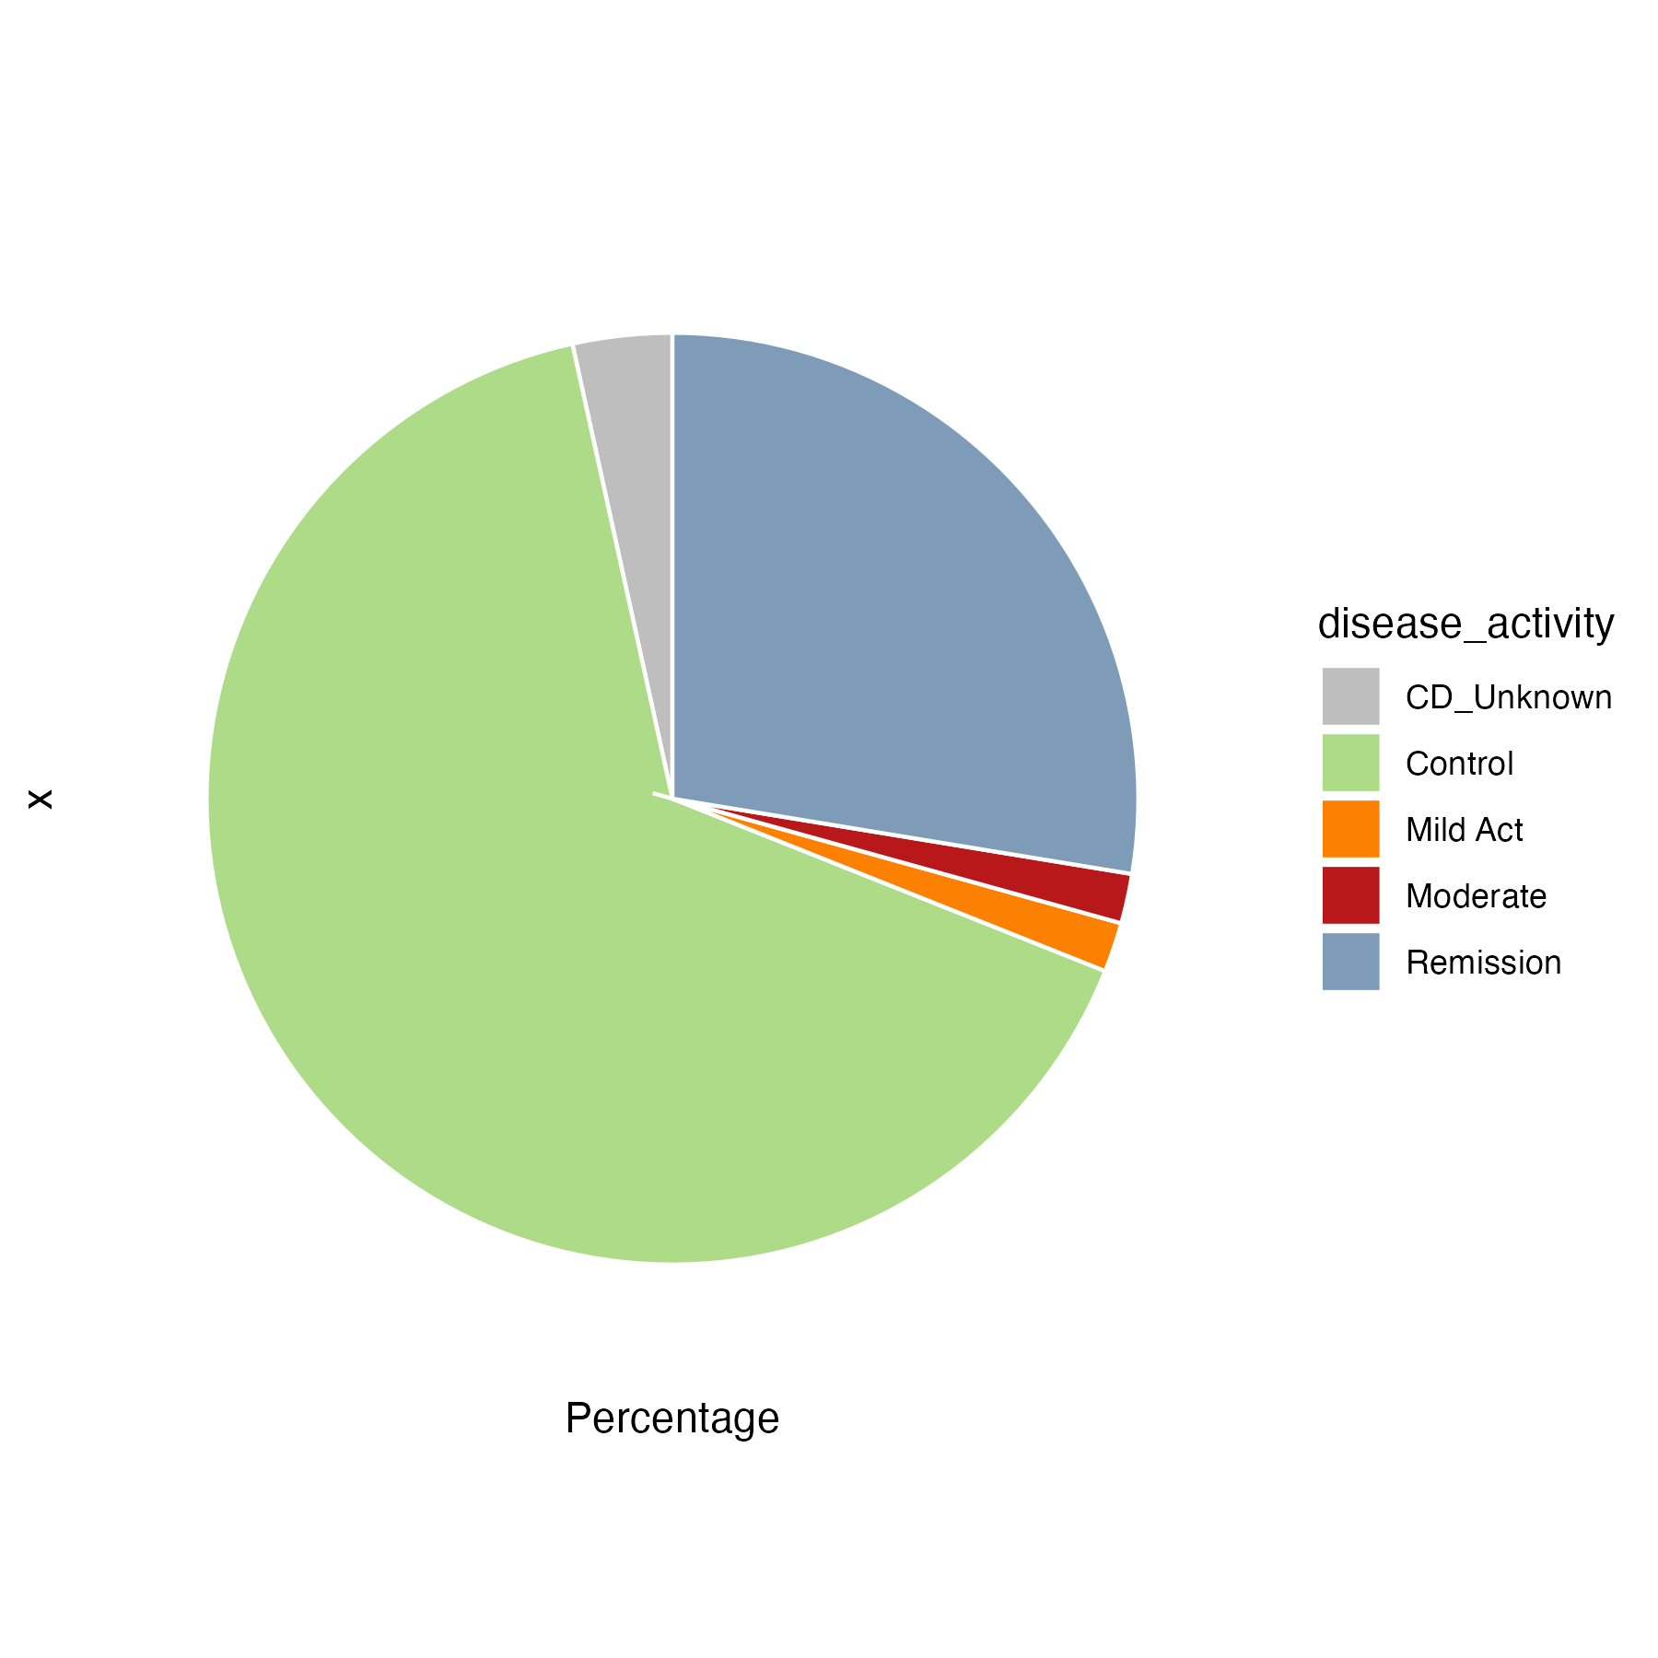
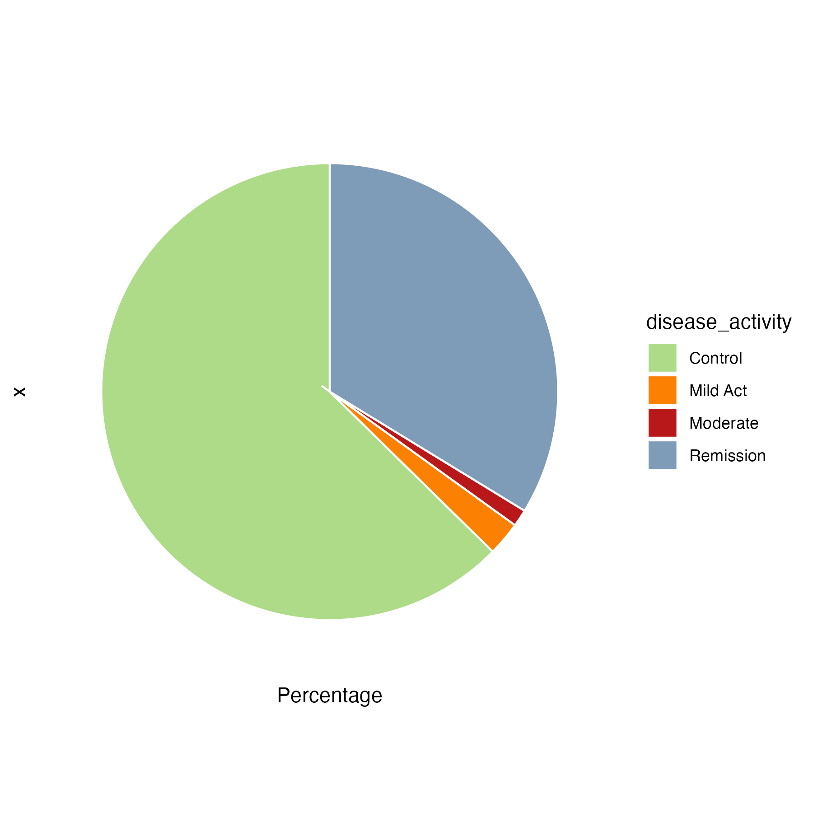
Comparison | P_Value | Statistic
1 vs 2 | 4.84600464899138e-08 | 5280
1 vs 3 | 0.0035758990799614 | 4526
1 vs 4 | 0.16759359696115 | 3826
1 vs 5 | 0.13372036842916 | 7285
1 vs 6 | 3.09661002627813e-07 | 4772
1 vs 7 | 0.000571622117726088 | 2100
2 vs 3 | 4.72894689433981e-06 | 871
2 vs 4 | 2.04045575238199e-08 | 634
2 vs 5 | 5.93933372017608e-05 | 1946
2 vs 6 | 0.964682568386495 | 1545
2 vs 7 | 0.717506628613208 | 660
3 vs 4 | 0.00528100166625685 | 1153
3 vs 5 | 0.272859176442194 | 2858
3 vs 6 | 0.000772380016820984 | 2141
3 vs 7 | 0.00548215196472399 | 985
4 vs 5 | 0.138221665415586 | 3452
4 vs 6 | 1.74948754378218e-06 | 2273
4 vs 7 | 4.73436517748851e-05 | 1060
5 vs 6 | 0.0104817392871642 | 3574
5 vs 7 | 0.0451742523331871 | 1636
6 vs 7 | 0.52714860239079 | 578

Slide 21
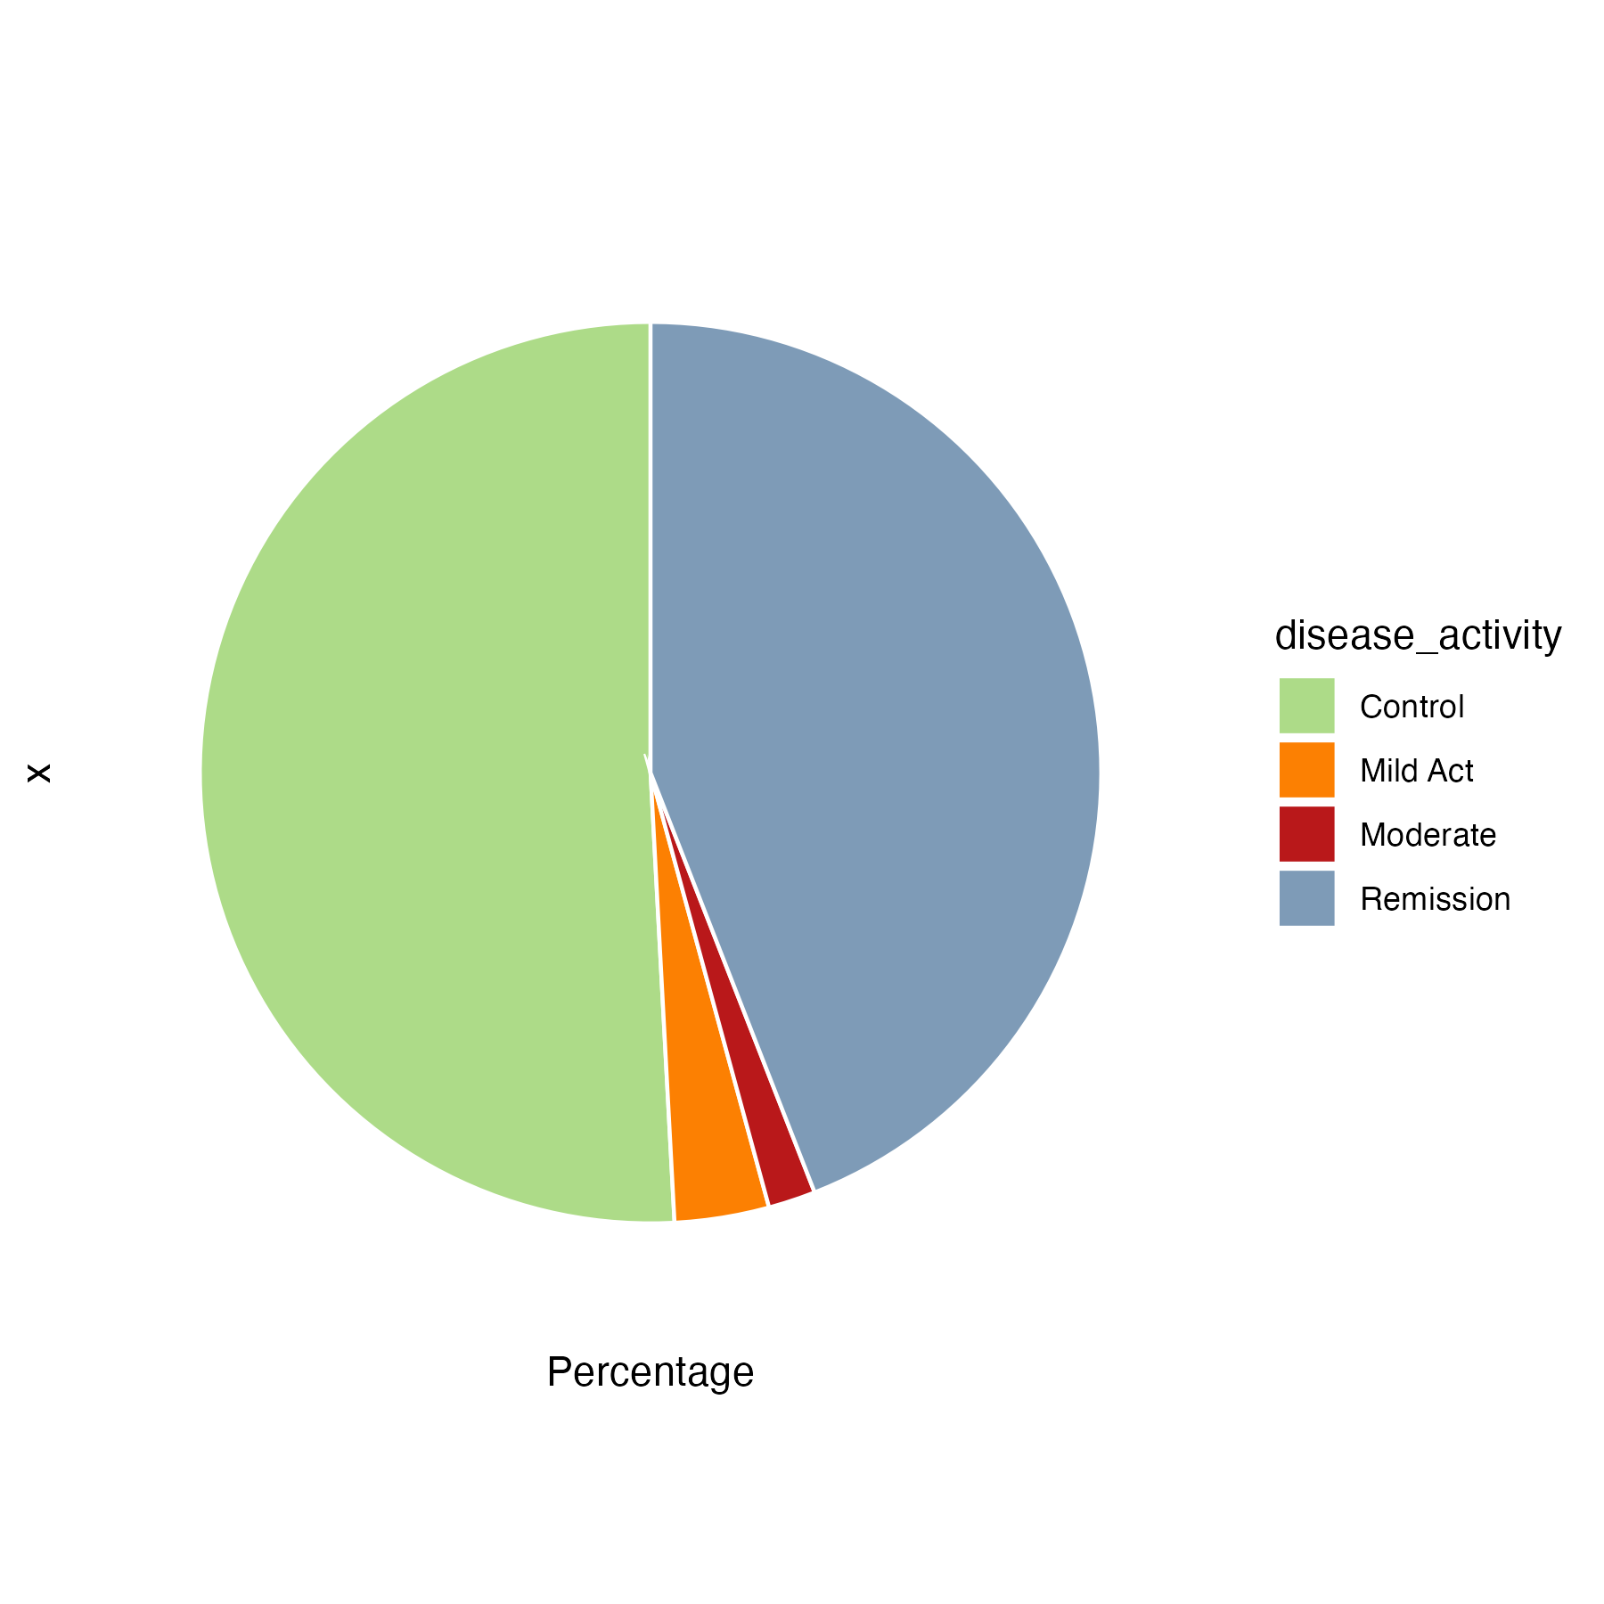

Slide 22
CD-enriched species
(n=6)
Escherichia coli
Erysipelatoclostridium ramosum
Enterococcus faecalis
Enterococcus faecium
Fusobacterium nucleatum
Limosilactobacillus fermentum
CD-depleted species
(n=114)
Scaled(Log10(Matrix))

Slide 23
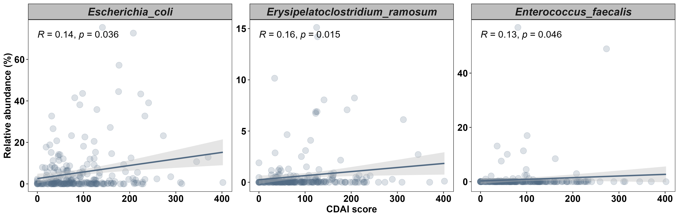
Three Species Consistently Correlated with Disease Activity (CDAI)

Slide 24
Functional Pathways Analysis Workflow
Relative Abundance of Pathways
Venn Diagram
Venn Diagram
Data Filtering
Venn Diagram
Bar Plots
MaAsLin2
Venn Diagram
Heatmap
CD-enriched and CD-depleted Pathways

Slide 25
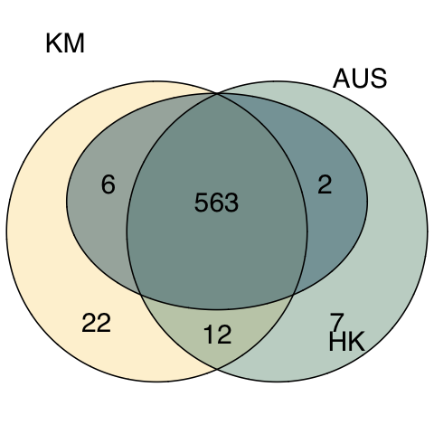
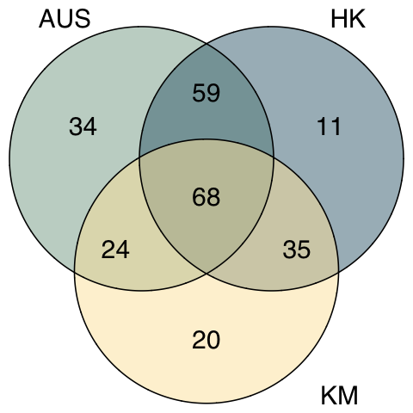
Venn Diagram for Pathways
Unfiltered
Filtered (p<=0.05)

Slide 26
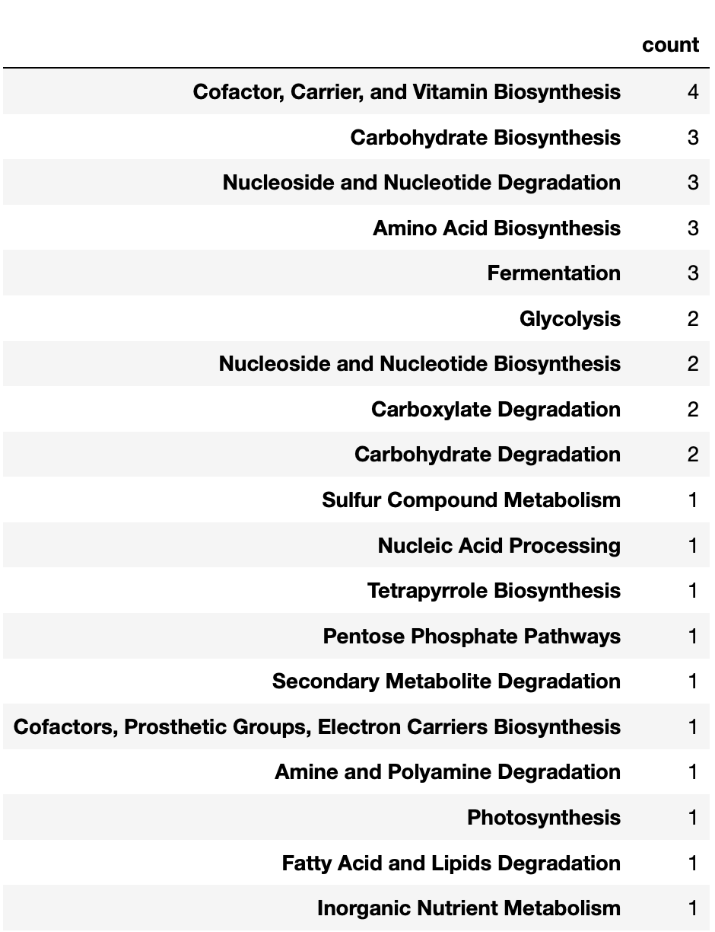
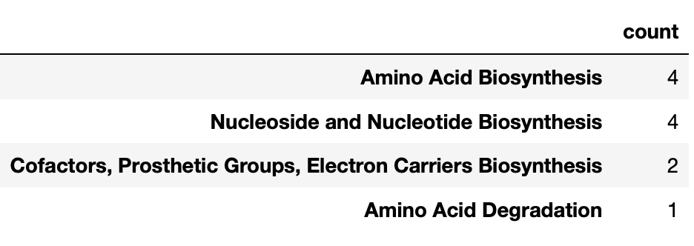
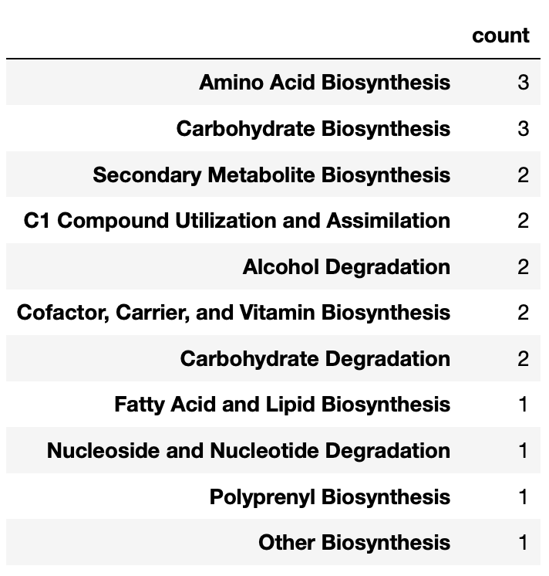
Functions from Unique Pathways in AUS, HK, and KM
Filtered (p<=0.05)
Notes:
Function 个数

Slide 27
CD-enriched and CD-depleted Pathways in AUS, HK, and KM
Most Frequent CD-enriched Functions:
Cofactor, Carrier, and Vitamin Biosynthesis
Fatty Acid and Lipid Biosynthesis
Amino Acid Biosynthesis
CD-enriched
CD-depleted
Most Frequent CD-depleted Functions:
Cofactor, Carrier, and Vitamin Biosynthesis
Cell Structure Biosynthesis
Amino Acid Biosynthesis
Coef

Slide 28
Bacterial Species contributing to CD-enriched and CD-depleted Pathways
CD-depleted
CD-enriched
Relative Abundance

Slide 29
Functions contributed by Faecalibacterium prausnitzii
 | Count
Amino Acid Biosynthesis | 14
Cofactor, Carrier, and Vitamin Biosynthesis | 11
Nucleoside and Nucleotide Biosynthesis | 10
Carbohydrate Biosynthesis | 8
Cell Structure Biosynthesis | 5
Fatty Acid and Lipid Biosynthesis | 5
Carbohydrate Degradation | 5
Nucleoside and Nucleotide Degradation | 4
Carboxylate Degradation | 3
Glycolysis | 2
Fermentation | 2
Aromatic Compound Biosynthesis | 2
Pentose Phosphate Pathways | 1
Amine and Polyamine Degradation | 1
Secondary Metabolite Degradation | 1
Nucleic Acid Processing | 1
Protein Modification | 1
Generation of Precursor Metabolites and Energy | 1
Aminoacyl-tRNA Charging | 1

Slide 30
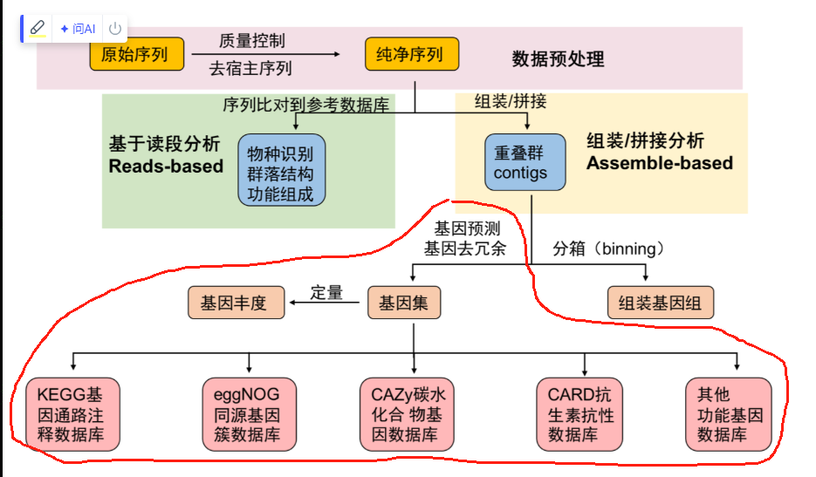
Microbial Gene Annotation Workflow
Assembly to Contigs
(MEGAHIT)
Gene Prediction
(Prodigal)
Gene Cluster
(MMseq2)
Gene Abundance
Non-redundant Gene Catalog
(1379 7256 genes)
Gene Database

Slide 31
Microbial Gene Analysis Workflow
Genome Assembly Data (Gene Count)
Venn Diagram
Venn Diagram
Data Filtering
Venn Diagram
Volcano Plots
DESeq2
Venn Diagram
Heatmap
CD-enriched and CD-depleted Genes

Slide 32
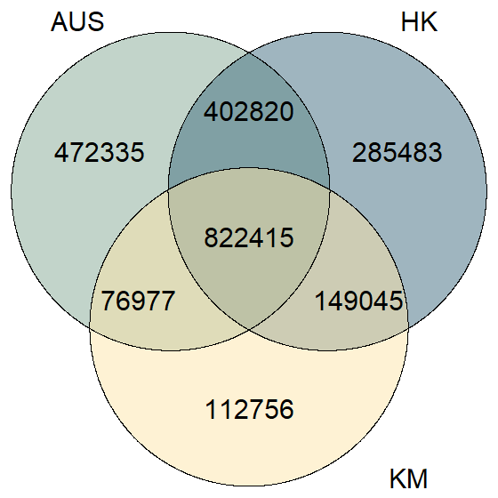
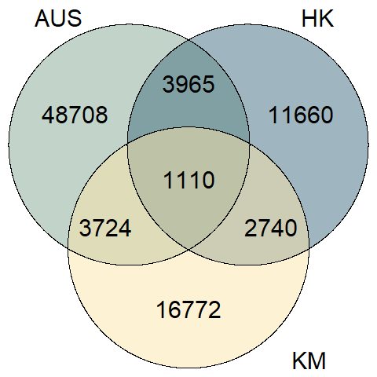
Venn Diagram for Microbial Genes
Unfiltered
Filtered (p<=0.05)
Notes:
left side: based on raw gene count; right side: based on DESeq2 output

Slide 33
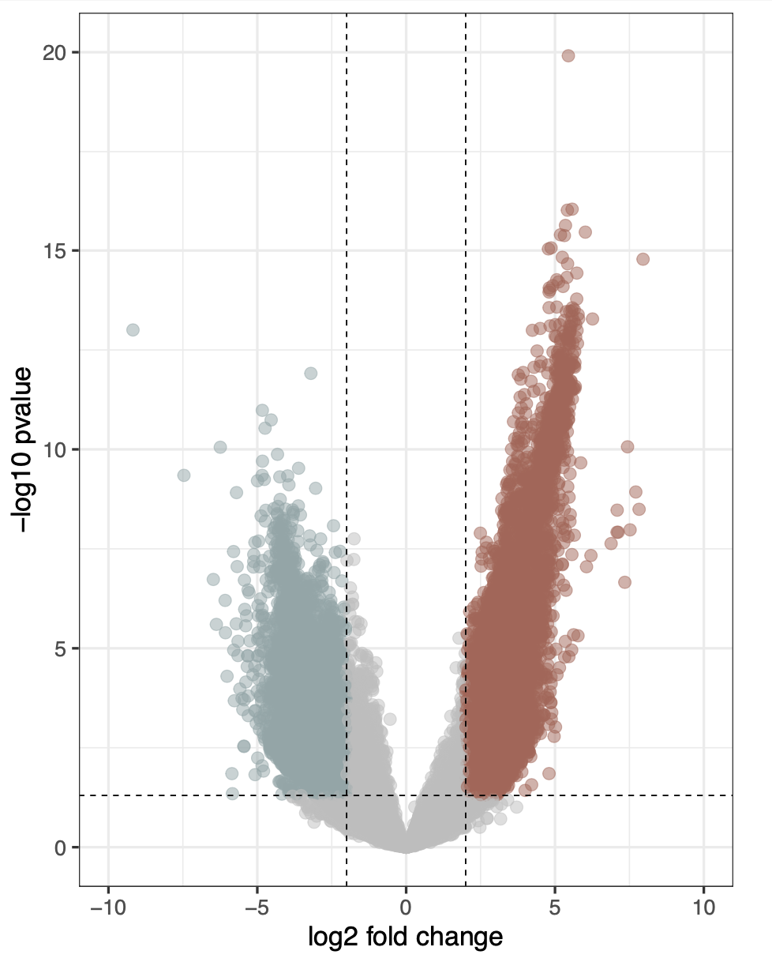
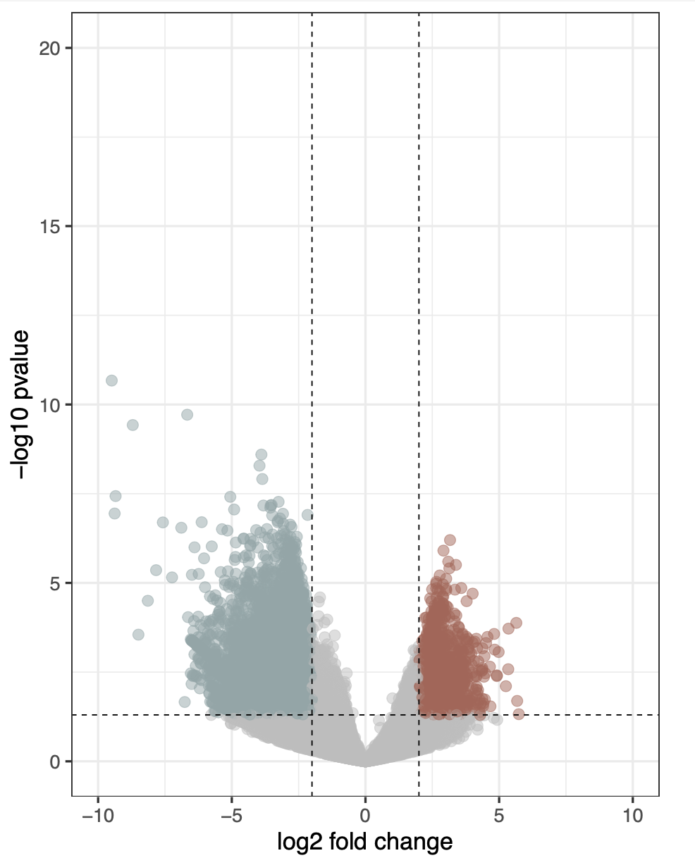
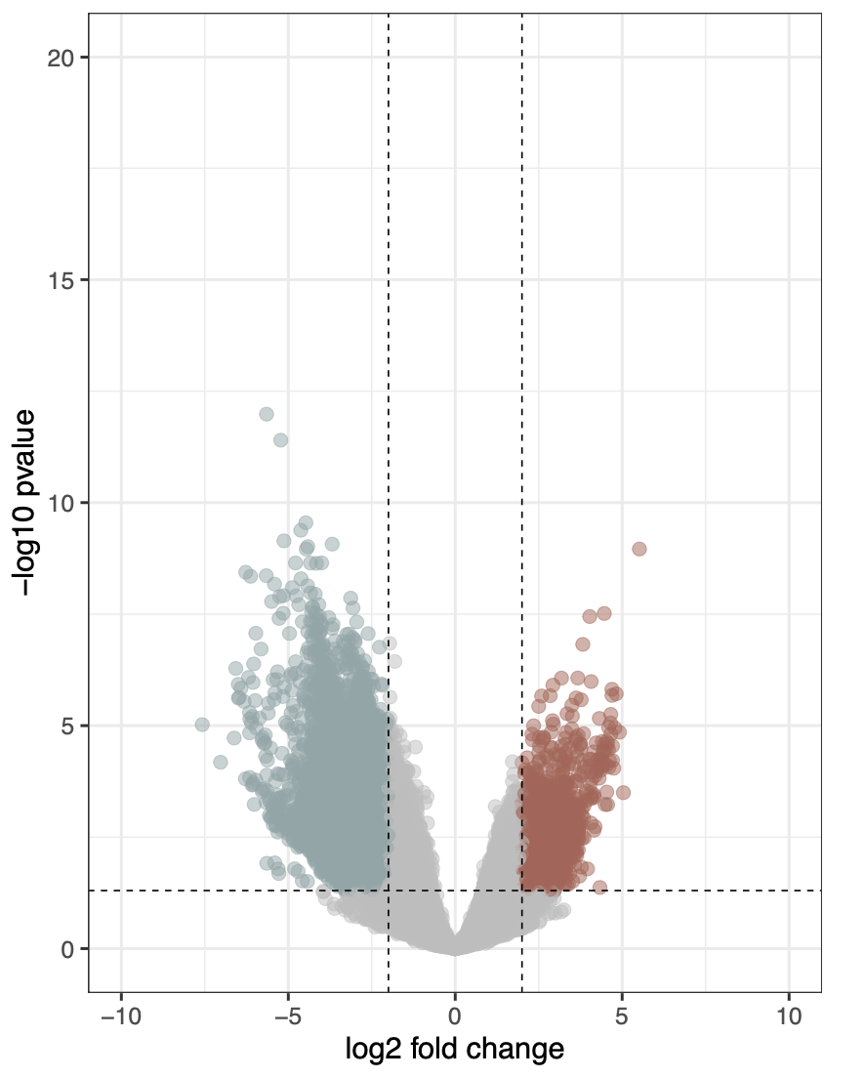
CD-enriched and CD-depleted Microbial Genes in AUS, HK, and KM
CD-depleted
CD-enriched
CD-depleted
CD-enriched
CD-depleted
CD-enriched
AUS
HK
KM
26160
8080
12655
1856
11591
2268
Cutoff for log2 FC is 2
Cutoff for p-value is 0.05
Cutoff for log2 FC is 2
Cutoff for p-value is 0.05
Cutoff for log2 FC is 2
Cutoff for p-value is 0.05

Slide 34
Microbial Gene Annotation Workflow
126
Virulence Factor Genes (VFGs)
1077
864
|log2 FC| > 2
Microbial genes consistently up- and down-regulated in CD patients cross AUS, HK, and KM
57
Antibiotic Resistance Genes (ARGs)
p<=0.05
Notes:
Venn Diagram: Based on DESeq output

Slide 35
CD-enriched and CD-depleted Microbial Genes in AUS, HK, and KM
CD-depleted
CD-enriched
CD-depleted
CD-enriched
CD-depleted
CD-enriched
AUS
HK
KM
smeS
acrB
26160
8080
12655
1856
11591
2268
kpsF
gspF
clbB
Erm(37)
wcbR
lpfC
cpxA
otr(A)
Cutoff for log2 FC is 2
Cutoff for p-value is 0.05
Cutoff for log2 FC is 2
Cutoff for p-value is 0.05
Cutoff for log2 FC is 2
Cutoff for p-value is 0.05

Slide 36
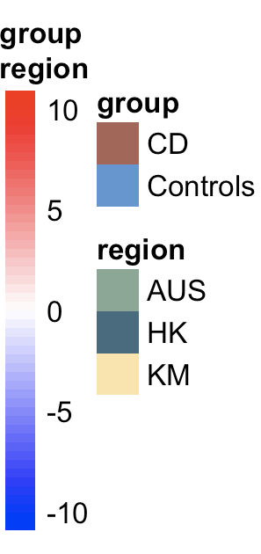
VFGs constantly up- and down-regulated in CD patients cross AUS, HK, and KM
CD-depleted VFGs
(n=48)
CD-enriched VFGs
(n=78)
Notes:
Scale

Slide 37
ARGs constantly up- and down- regulated in CD patients cross AUS, HK, and KM
Notes:
CD-enriched vs CD-depleted = 30:27
后缀

Slide 38
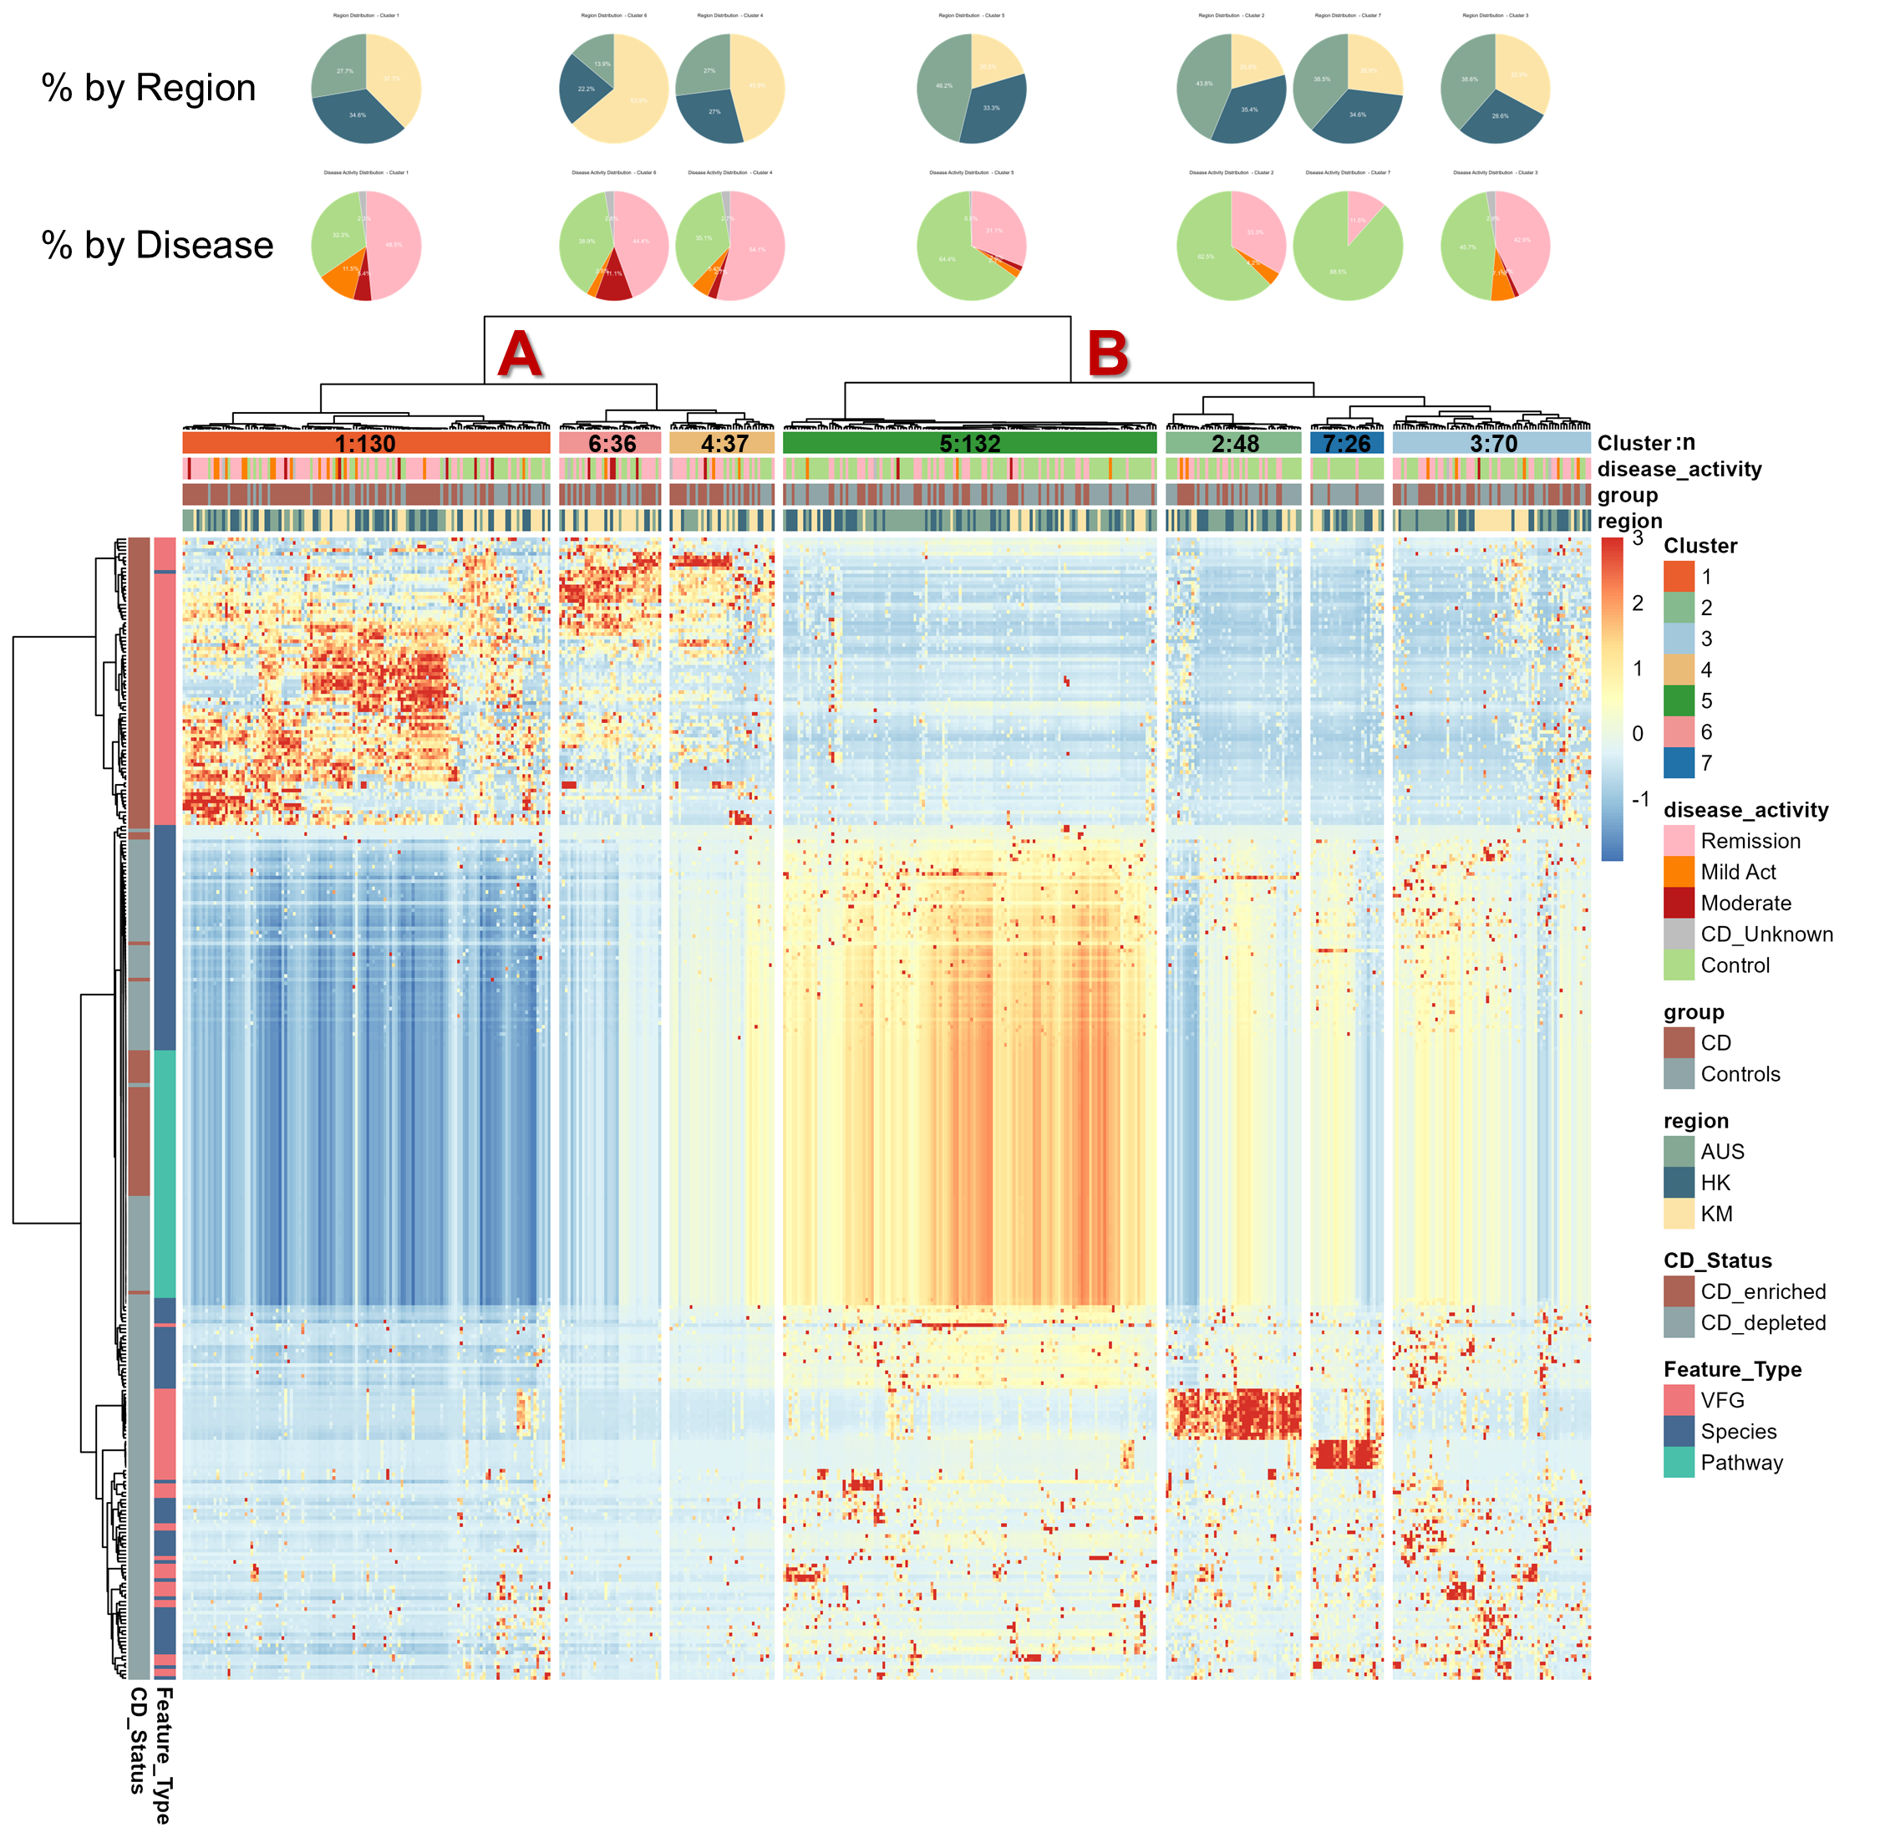
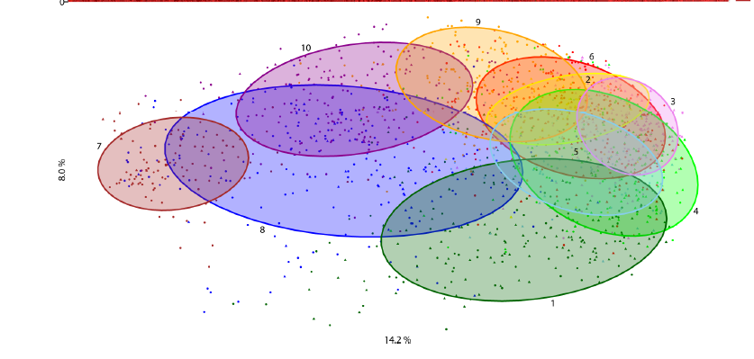
Notes:
remission= inactive，mild和moderate = active
more CD patients concentrated in cluster A, while more healthy individuals made of cluster B
The heatmap showed us how the multi-omic signatures of CD patients and healthy individuals look like
We made association networks based on the two big clusters derived from this plot: cluster A and cluster B
To better describe the multi-omic signature of all seven clusters, we will make more detailed analysis in the next step

Slide 39
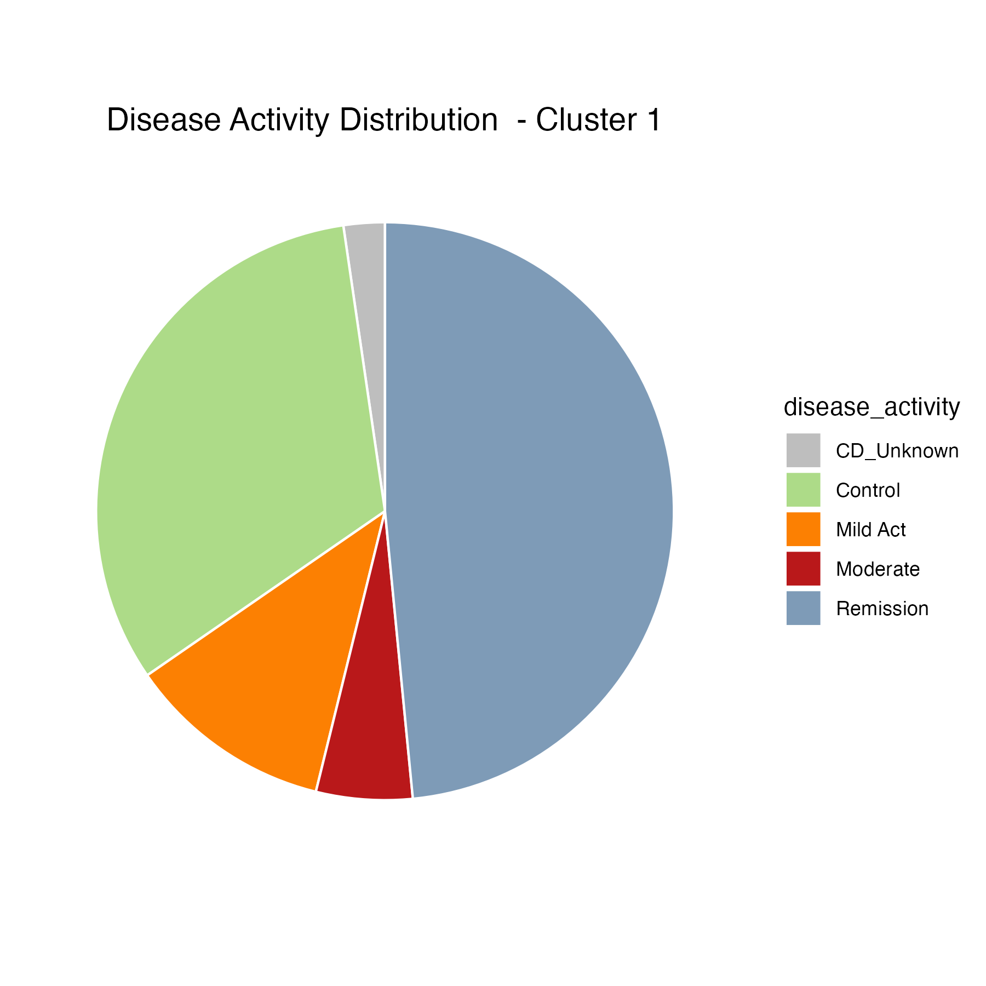
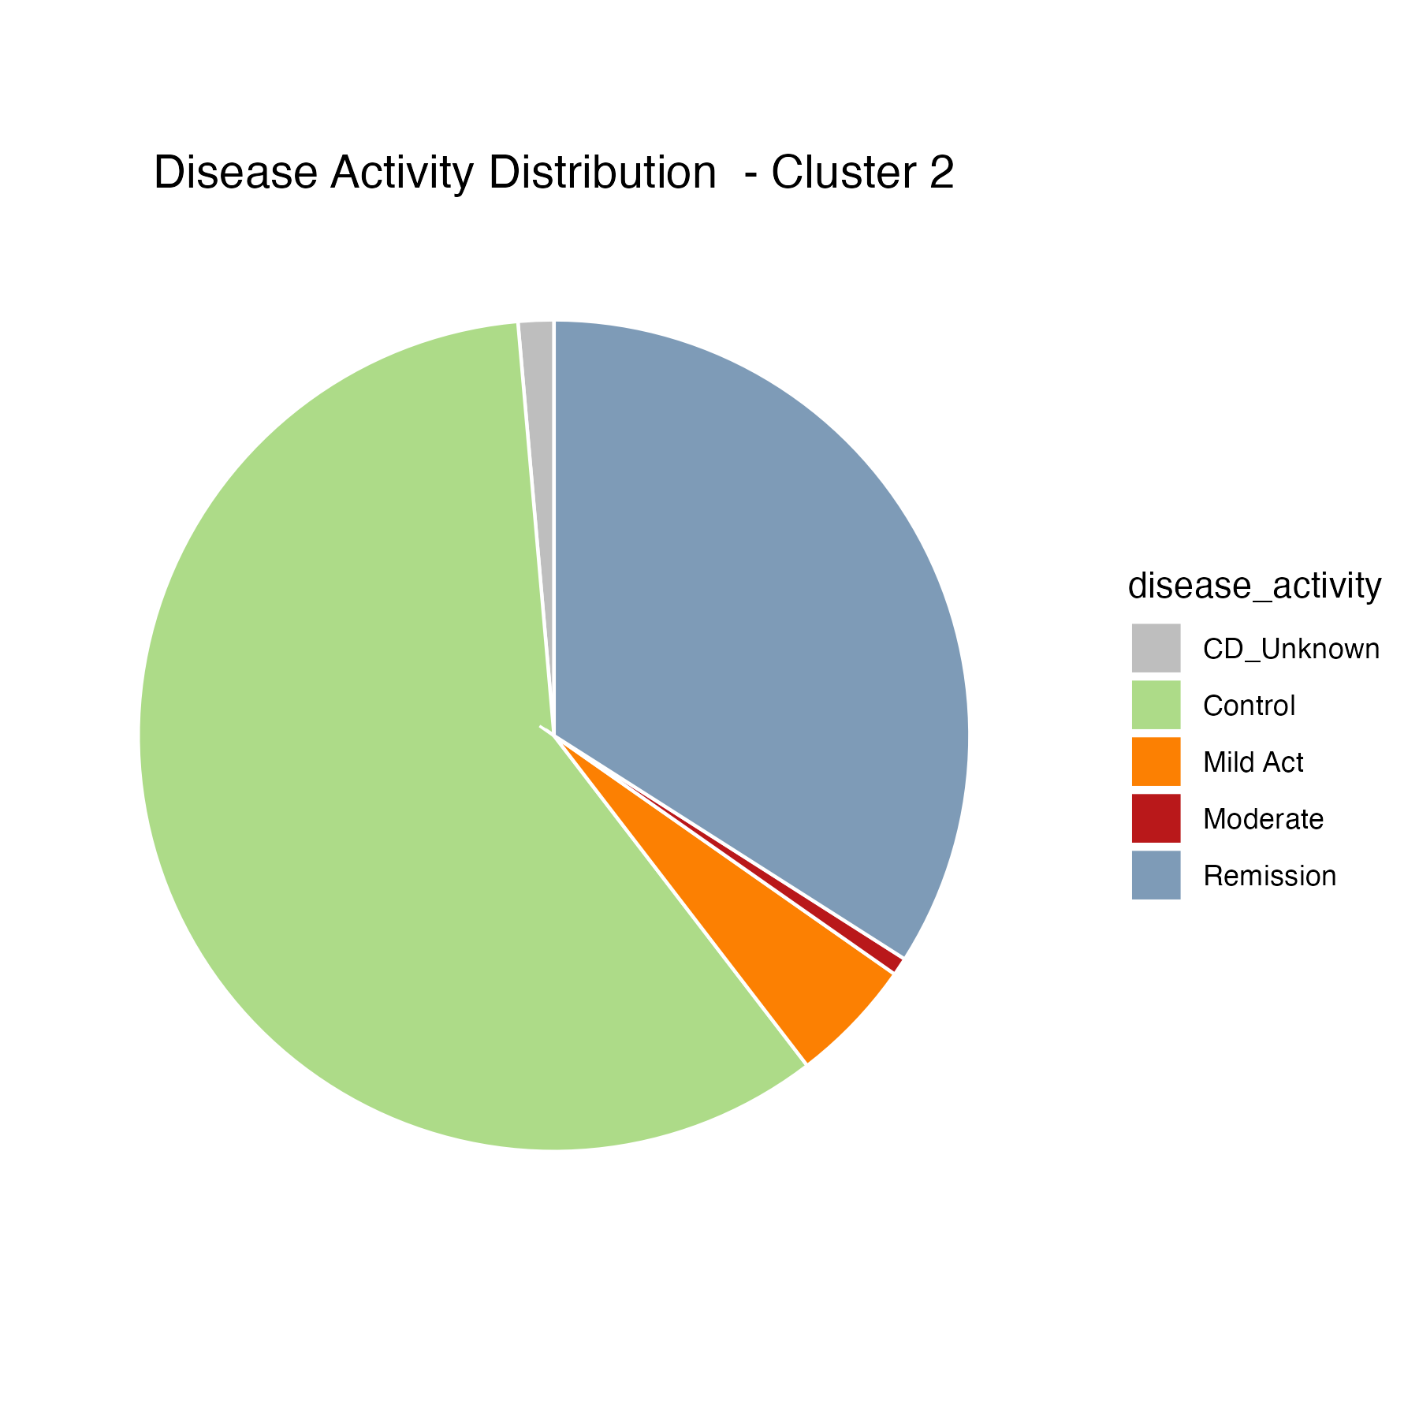
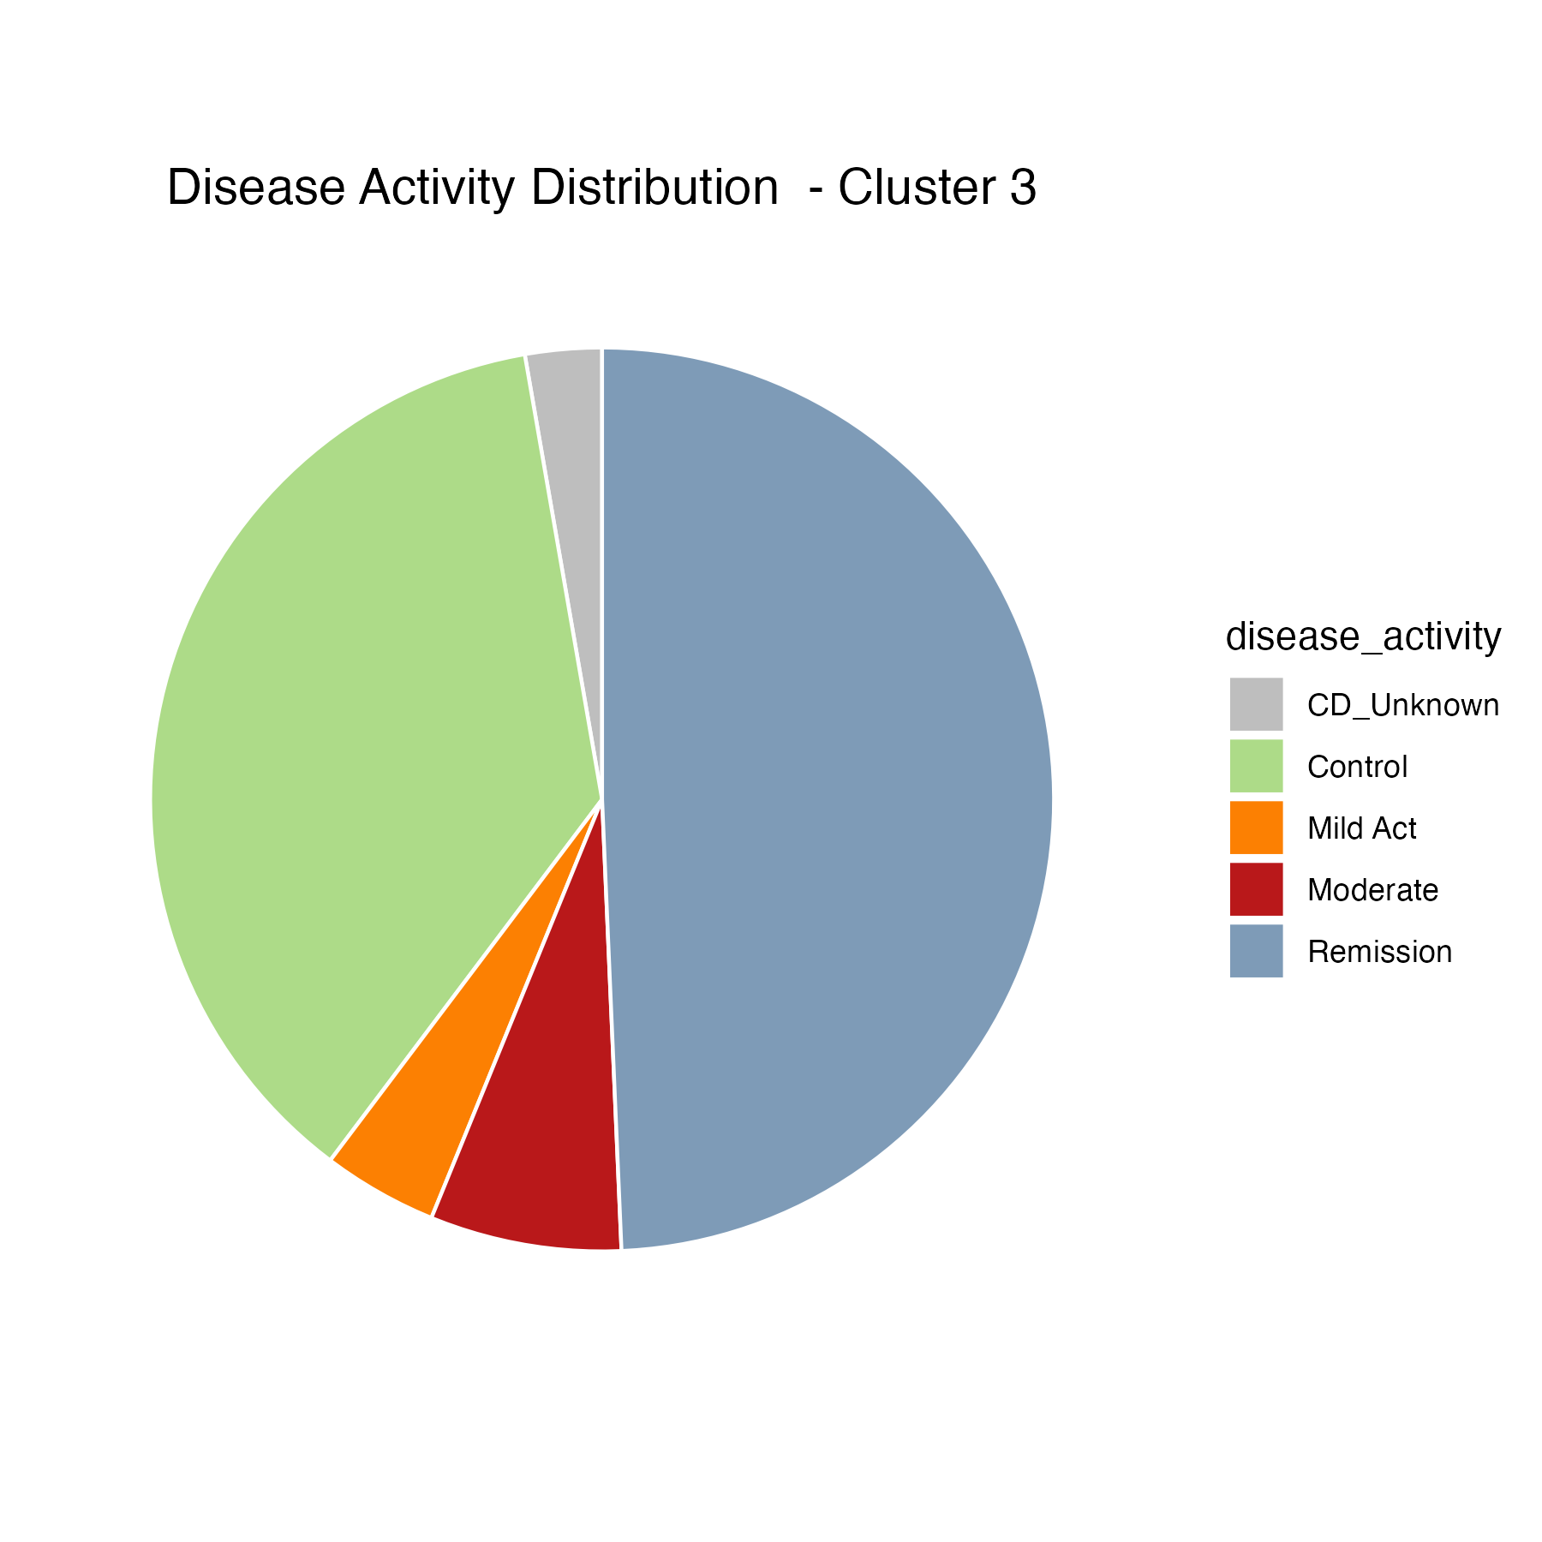
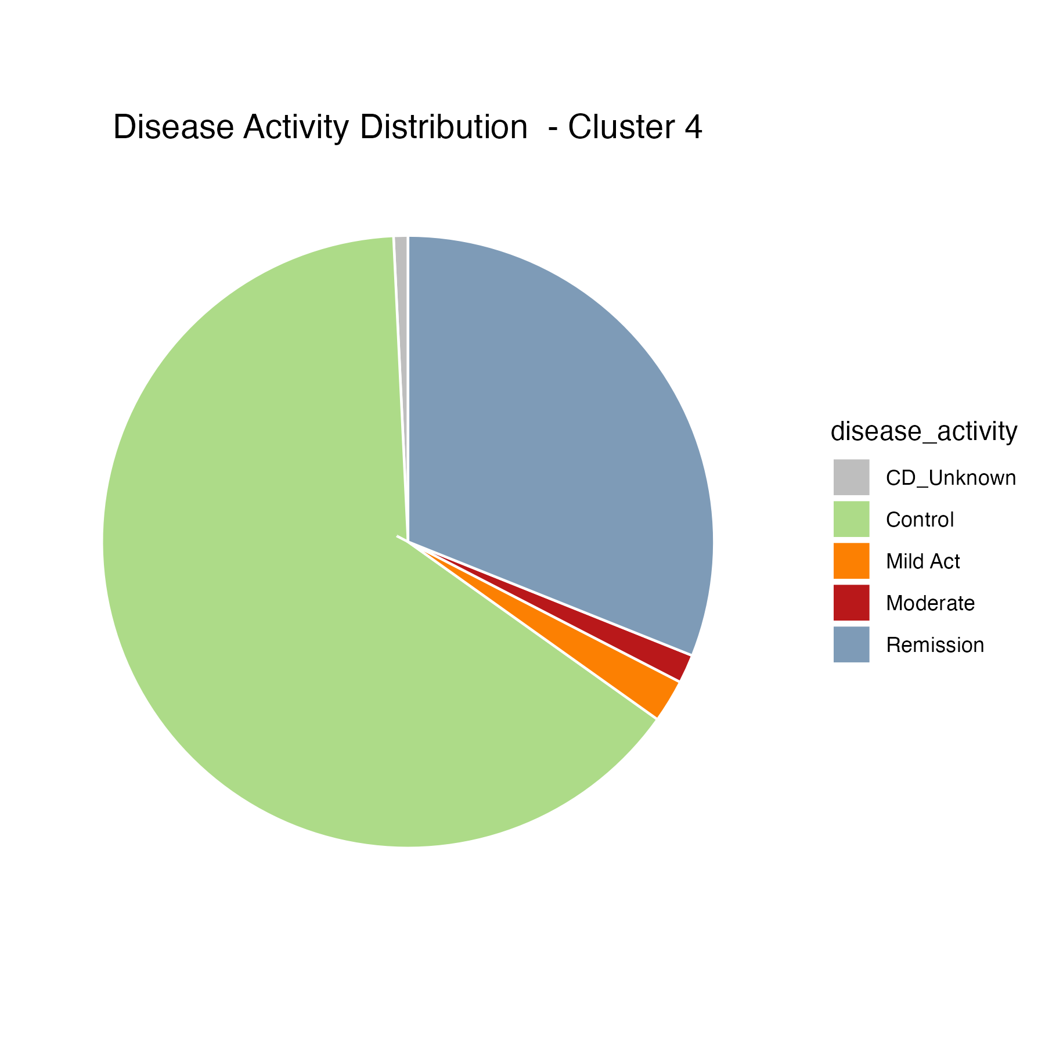
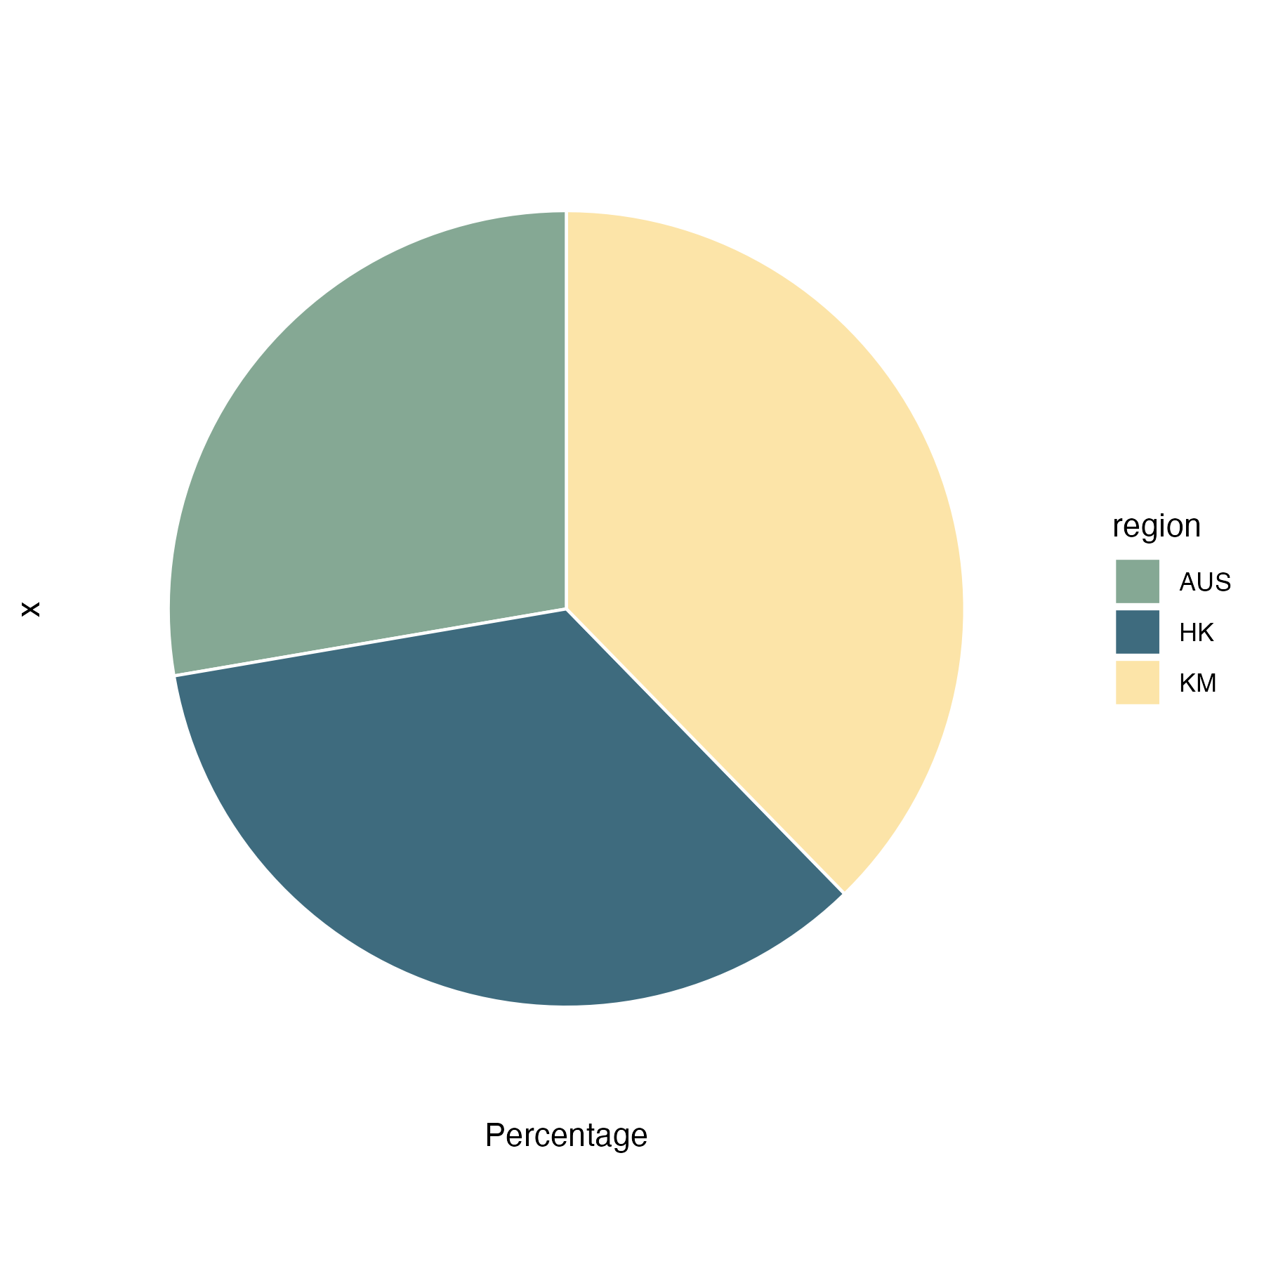
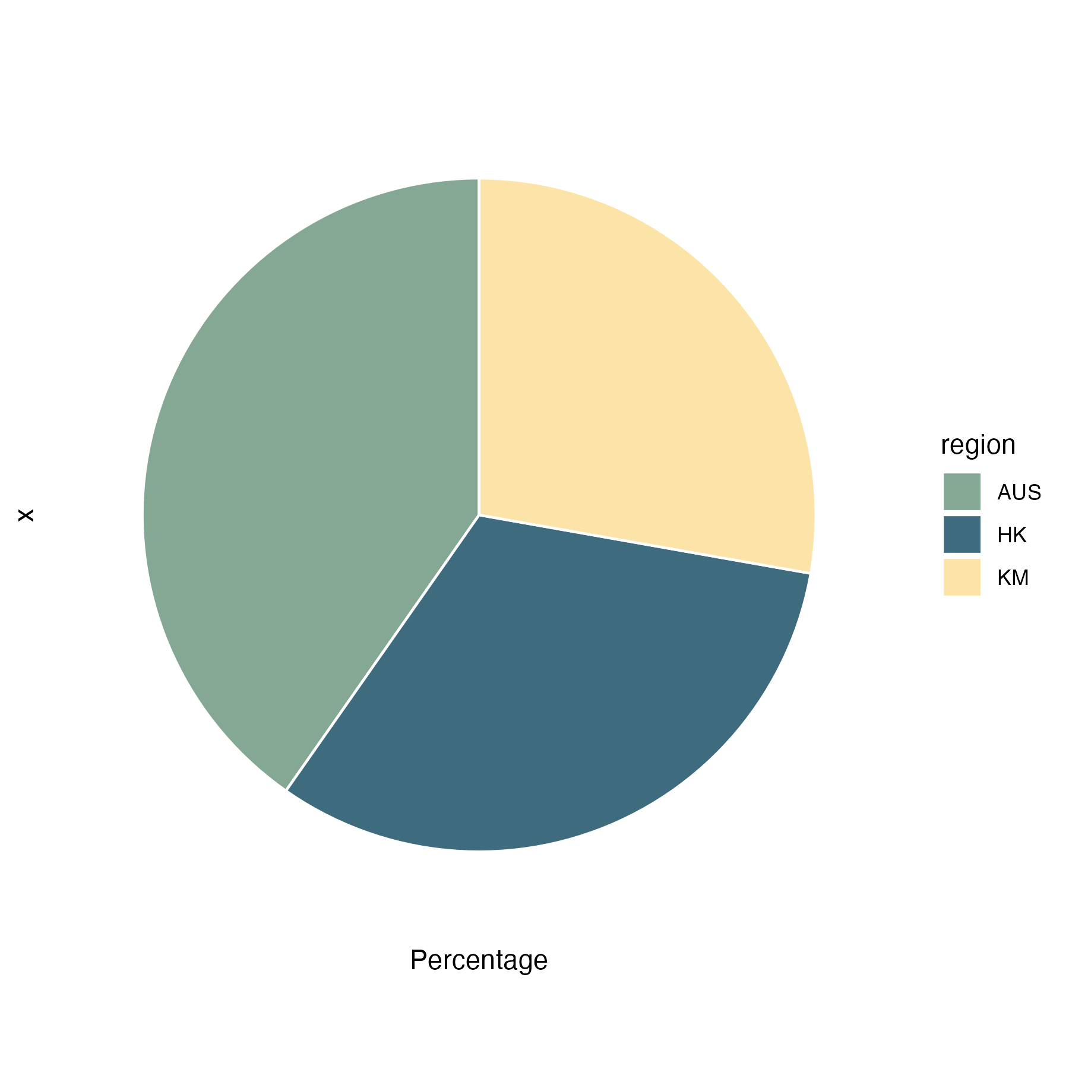
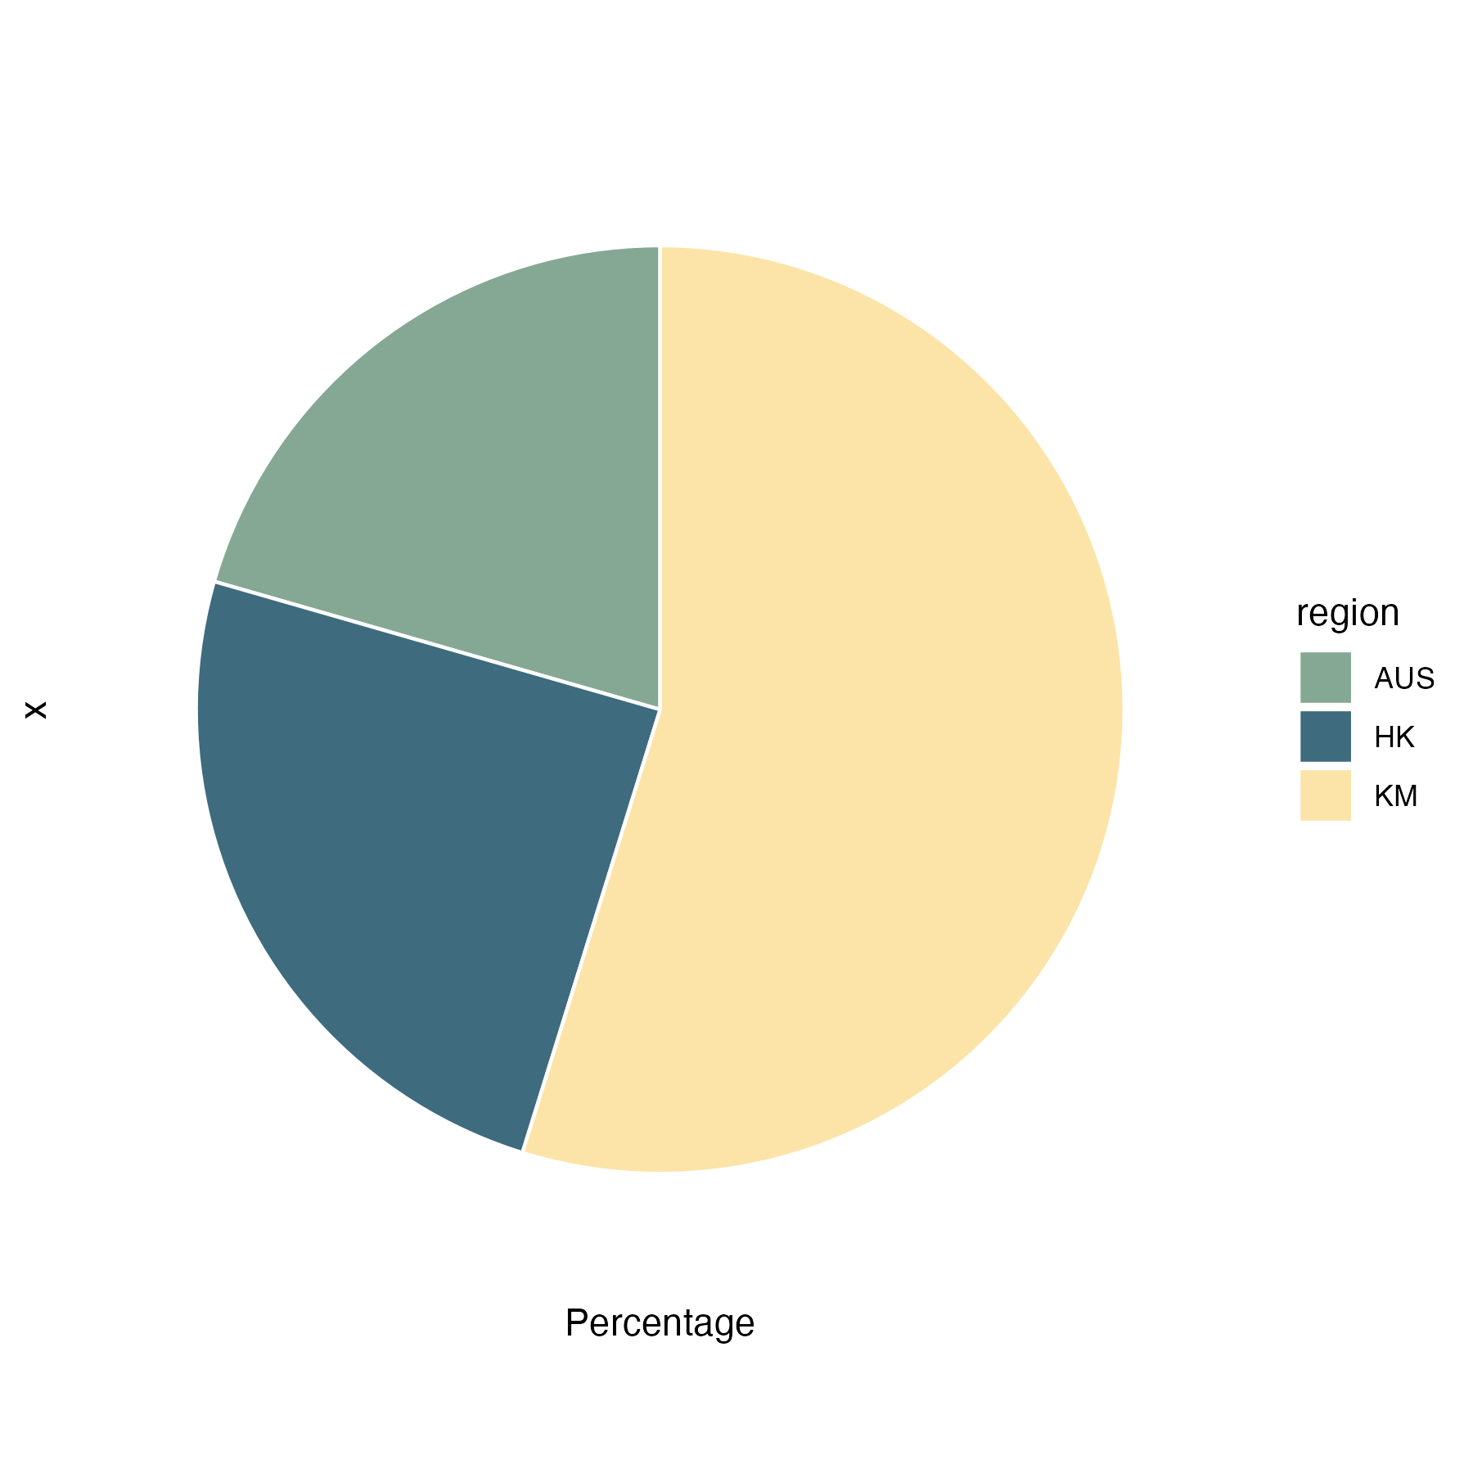
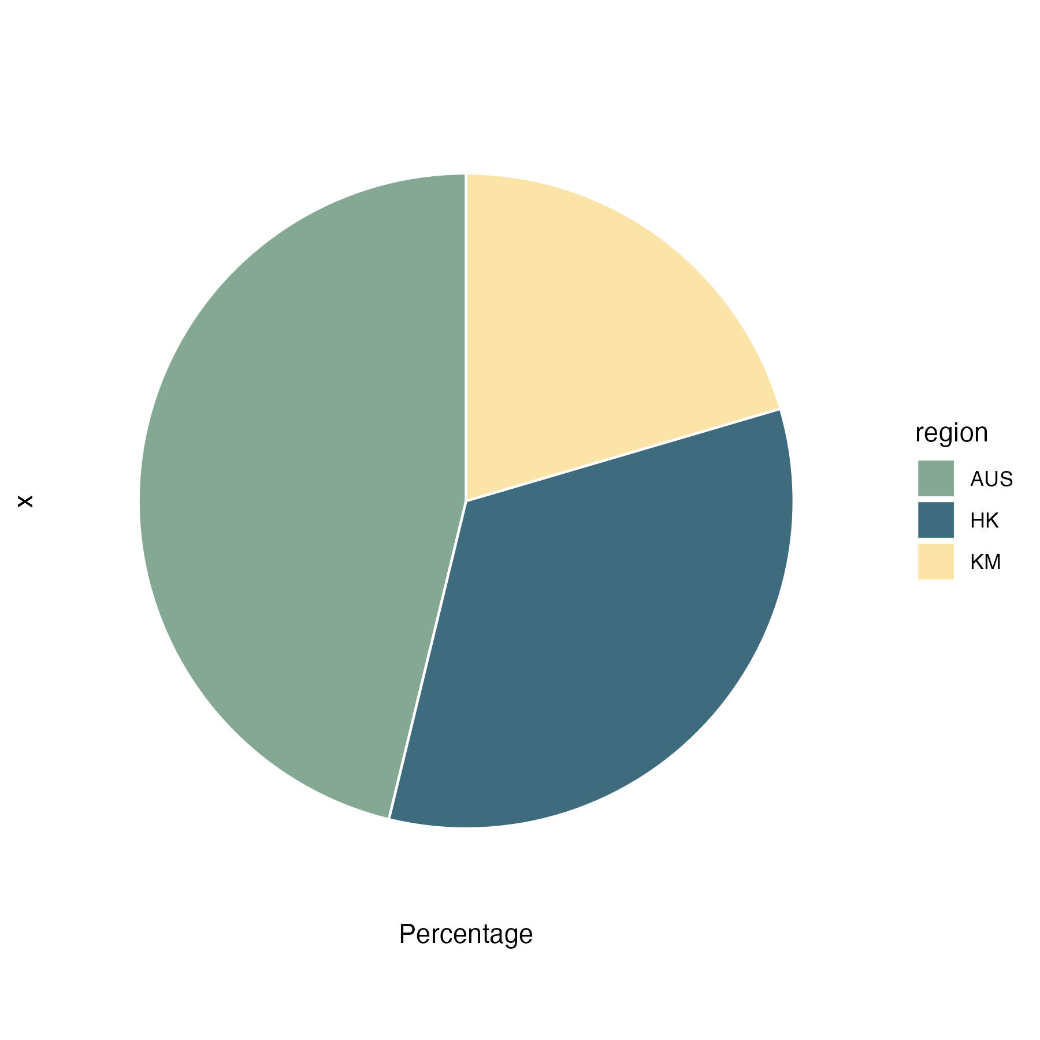

Slide 40
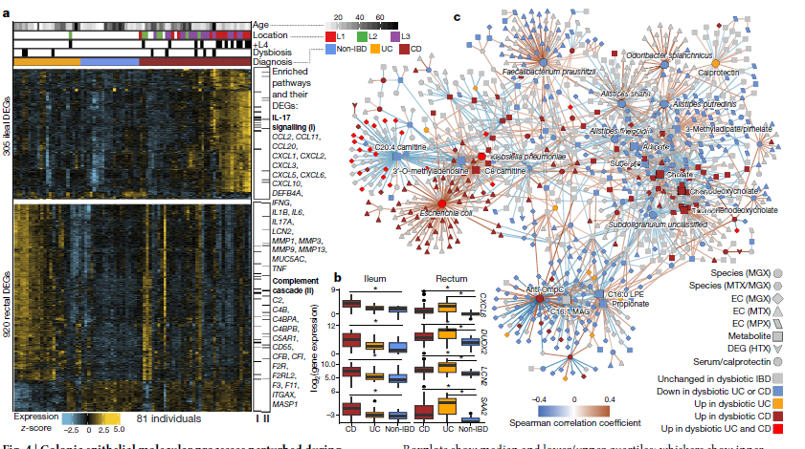
Notes:
Multi-omics of the gut microbial ecosystem in inflammatory bowel diseases

Slide 41
Maaslin2
Active vs inactive (HK)
Active vs inactive (AUS)
Any overlap?
Active vs inactive (KM)
Active vs inactive (ALL)

Slide 42
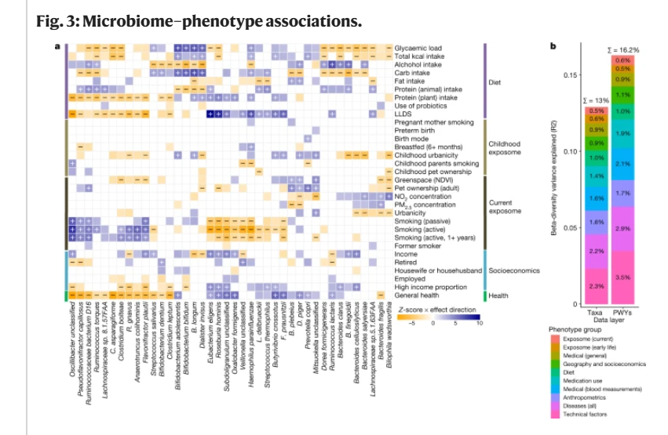
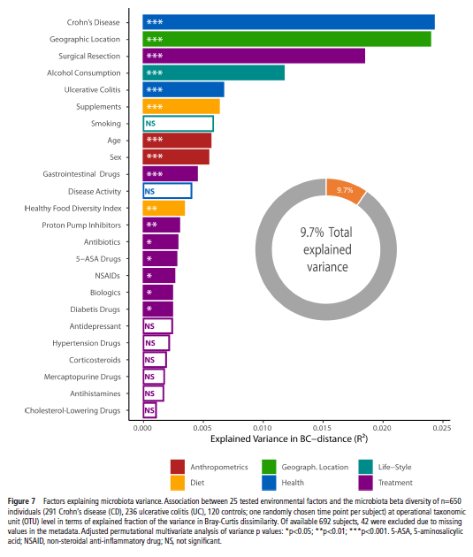
Notes:
Ranking microbiome variance in inflammatory bowel disease: a large longitudinal intercontinental study
Environmental factors shaping the gut microbiome in a Dutch population

Slide 43
Notes:
Environmental factors shaping the gut microbiome in a Dutch population

